Slide 1





Langham Place
China Social Media Report
Aug 2026

Slide 2
Agenda
August 2026 Summary
  Followers Analysis
  Content Analysis
  Competitor Insights
  KOL Campaign Analysis
Learnings & Suggestions

Slide 3


August Performance Summary
Driven by the Chiikawa movie launch, F&B and local lifestyle content, all channels recorded steady fan growth and engagement in Aug.
XHS continued to lead in engagement and recorded the highest net fan growth among all channels.
WeChat saw strong engagement performance with an engagement rate of 12.49% , while Channel maintained steady growth with monthly views exceeding its target at 236.78% .
Douyin recorded steady fan growth and monthly views.
A total of 3,395.84 RMB was spent on ad boosting, primarily on XHS to maximize reach for content posts and drive engagement.
Total Performance
Paid Performance
KPI Achievement
July 2026
Fans Number | 23,769 | 41,780 | 534 | 2,903
Fans Net growth | 884 | 226 | 5 | 250
No. of Post | 5 | 3 | 3 | 4
Total Views | 22,324 | 1,041 | 11,839 | 20,080
Total Engagement | 2,751 | 130 | 75 | 841
Engagement Rate | 12.32% | 12.49% | 0.63% | 4.19%
Channel | Cost | Total Impressions | Total Engagement
 | ¥2,012.64 | 27,954 | 1,532
 | ¥253.2 | 9,484 | 25
 | ¥1,130 | 30,510 | 1,401
Total | ¥3,395.84 | 67,948 | 2,958
XHS
92.57%
82.13%
84.20%
Fans Growth (5,554/ 6,000)
Engagement Rate (12.32% / 15%)
Fans Community (421 / 500)
WeChat
60.59%
83.28%
Total Views: 8,089/15,000
Monthly Views: 1,041/1,250
Channel
236.78%
119.23%
Monthly Views: 11,839/5,000
Yearly Views: 71,535/60,000
Douyin
74.73%
334.67%
Fans growth: 1,121/1,500
Monthly Views: 20,080/6,000
KOL Campaign
51.63%
137.31%
Total Views: 929,382/1,800,000
Avg Engagment: 5,767/4,200

Slide 4
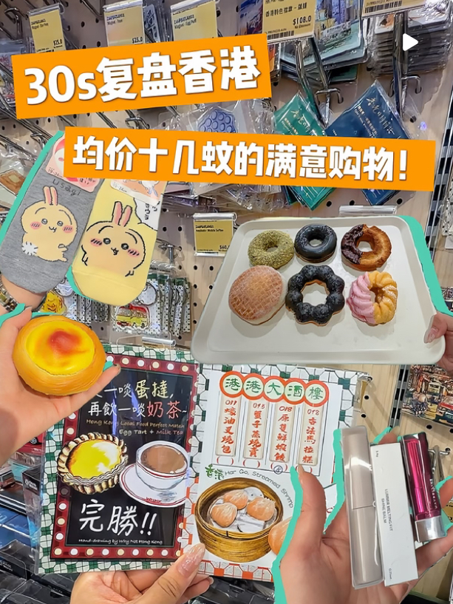
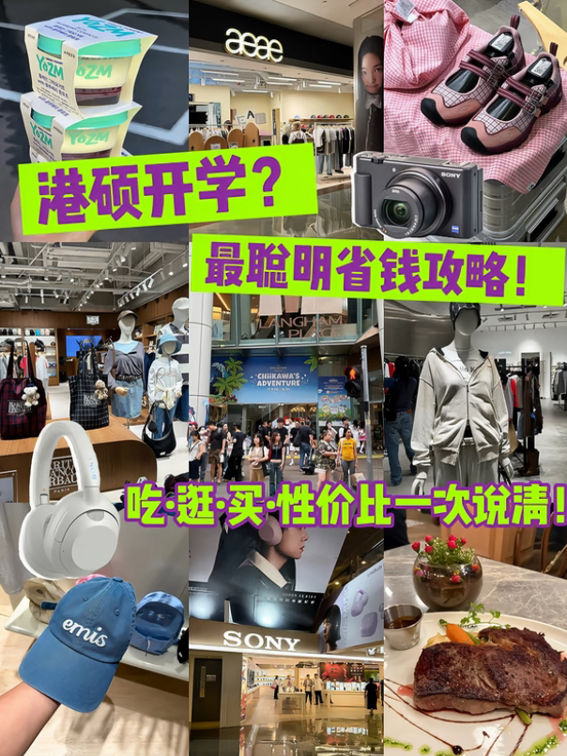
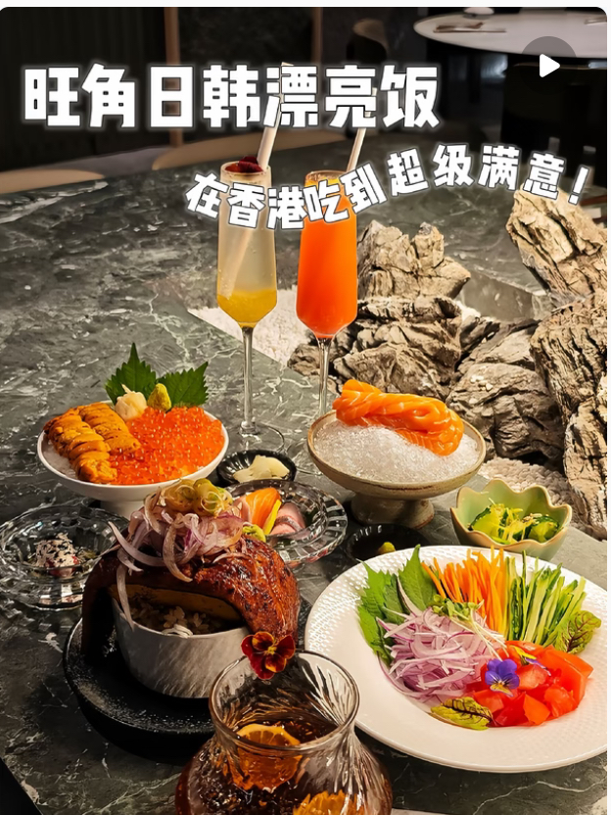
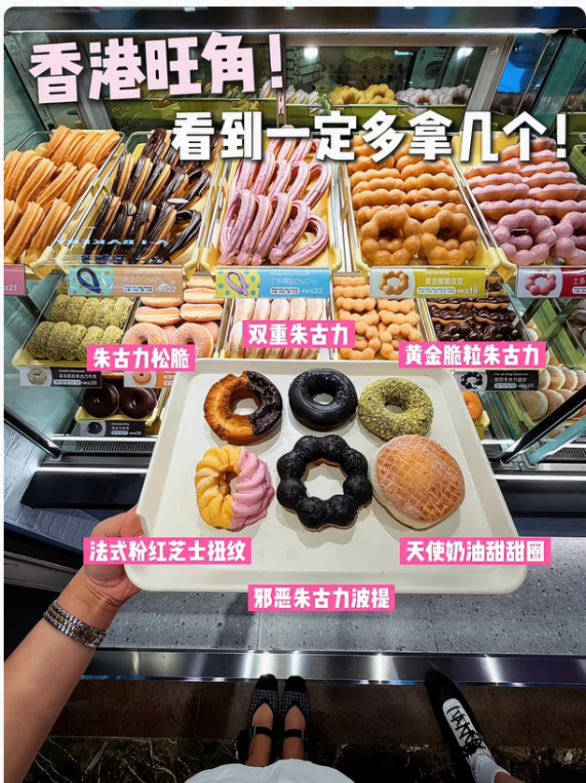
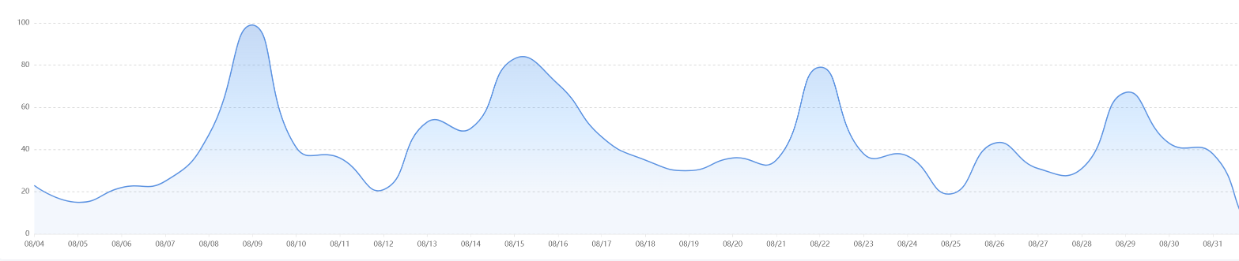
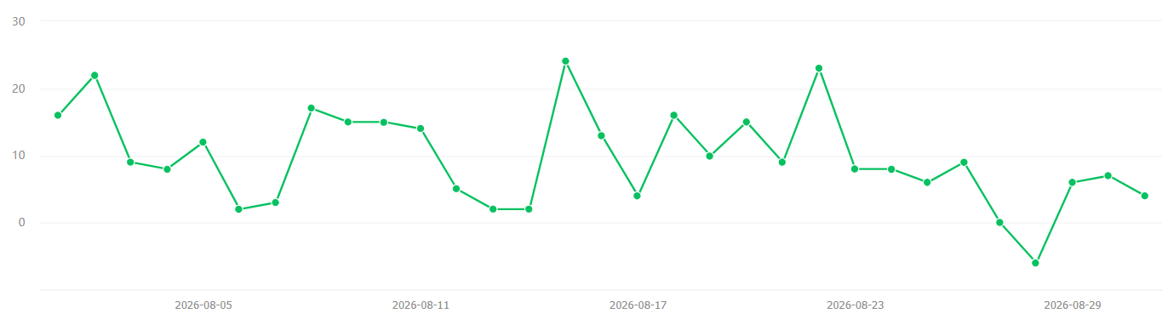

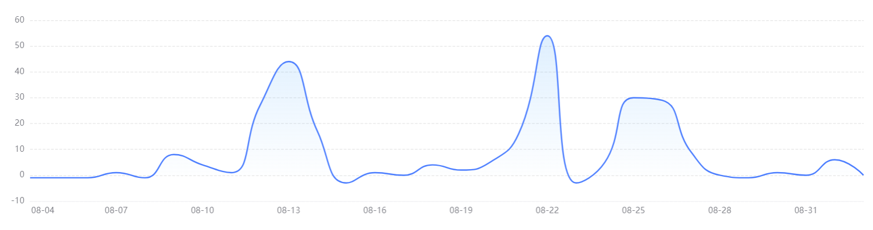
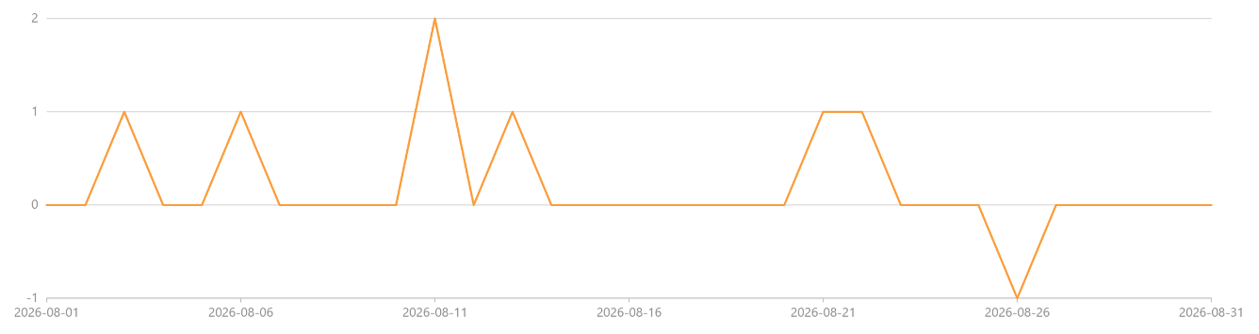
Fans Acquisition - Daily
In Aug, XHS's fan growth was driven by the Chiikawa movie launch and lifestyle content, with multiple spikes recorded throughout the month. The highest single-day net growth (+99) on 9 Aug, reflecting sustained audience interest in Chiikawa-related content.
WeChat (+226) and Douyin (+250) both continued to see steady fan growth, with Douyin maintaining strong momentum fueled by food and lifestyle content, supported by ad strategy that combines engagement optimization with follower acquisition.
9 Aug
+ 99
15 Aug
+ 83
15 Aug
+ 24
22 Aug
+ 23
22 Aug
+ 79
29 Aug
+ 67
2 Aug
+ 22
8 Aug
+ 17
22 Aug
+ 54
13 Aug
+ 44
25 -26 Aug
+ 59
21 Aug
+ 1
6 Aug
+ 1
11 Aug
+ 2
3 Aug
+ 1
13 Aug
+ 1

Slide 5
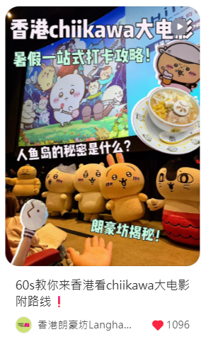
XHS Content Performance
In Aug, the Chiikawa movie guide was the month's top performer, recording the highest views and fan growth, along with notable engagement, reflecting strong demand for practical IP-related guides.
Back-to-school content recorded the highest engagement rate (19.03%), proving that content resonating with young audiences and mainland students, with strong 种草 appeal and practical offers, drives meaningful interactions.
Food and lifestyle content also delivered steady performance, reinforcing the appeal of affordable lifestyle content on XHS.
XHS Post | Publish Date | Subject | View | Like | Comment | Saved | Share | Total Engagement | Total Engagement Rate | Fans Increased
1 | Aug 3 | 人均150🍣在香港吃到了满意的漂亮饭！ | 4,533 | 326 | 4 | 65 | 61 | 456 | 10.06% | 13
2 | Aug 7 | 60s教你来香港看chiikawa大电影 附路线 | 10,869 | 1,099 | 31 | 222 | 242 | 1,594 | 14.67% | 78
3 | Aug 12 | 香港十几💰的美味！旺角记得多拿几个😭 | 1,376 | 129 | 1 | 51 | 37 | 218 | 15.84% | 12
4 | Aug 20 | 30s看在香港花的zui满意的几笔💰！ | 4,679 | 233 | 2 | 69 | 14 | 318 | 6.80% | 16
5 | Aug 28 | 没人说的港硕开学潜规则😭少流太多泪❗️ | 867 | 107 | 3 | 44 | 11 | 165 | 19.03% | 6
Aug Total |  |  | 22,324 | 1,894 | 41 | 451 | 365 | 2,751 | 12.32% | 125

Slide 6
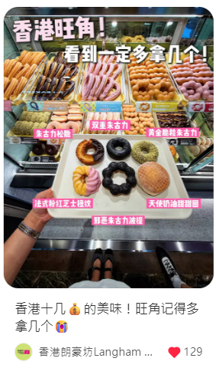
XHS Boosting performance
August XHS Boosting Performance:
CPE: ¥1.31, 13.2% lower vs Jul, 38.5% lower vs Aug 2025, and 50.9% lower vs 2025 avg, cost efficiency improved significantly.
CPM: ¥72.00, 17.7% lower vs Jul and 13.0% lower vs Aug 2025, but up 15.6% vs 2025 avg.
CTR: 8.53%, 14.8% lower vs Jul, 9.5% lower vs Aug 2025, and 1.0% lower vs 2025 avg.
Metric | Jan | Feb | Mar | Apr | May | Jun | Jul | Aug | vs Jul | vs Aug 2025 | vs 2025 Avg
CPE ¥ | ¥1.98 | ¥2.67 | ¥0.83 | ¥0.94 | ¥2.79 | ¥1.31 | ¥1.51 | ¥1.31 | ↓ 13.2% | ¥2.13 (↓ 38.5%) | ¥2.67 (↓ 50.9%)
CPM ¥ | ¥37.8 | ¥86.5 | ¥74.9 | ¥67.7 | ¥56.8 | ¥79 | ¥87.5 | ¥72 | ↓ 17.7% | ¥82.75 (↓ 13.0%) | ¥62.3 (↑ 15.6%)
CTR | 13.4% | 8.43% | 11.% | 11.2% | 10.8% | 10.1% | 10% | 8.53% | ↓14.8% | 9.43% (↓ 9.5%) | 8.62% (↓ 1.0%)
Category | XHS Subject | Period | Objectives | Cost￥ | Impressions | Clicks | Total Engagement | CTR | CPC ¥ | CPE ¥ | CPM ¥
聚光 | 『香港避暑』旺角邂逅金庸的武侠世界 | 8/1 | 互动量 | ¥148.74 | 2,204 | 168 | 126 | 7.62% | ¥0.89 | ¥1.18 | ¥67.49
 | 人均150🍣在香港吃到了满意的漂亮饭！ | 8/3 | 互动量 | ¥453.42 | 3,829 | 373 | 412 | 9.74% | ¥1.22 | ¥1.10 | ¥118.42
 | 60s教你来香港看chiikawa大电影 附路线 | 8/7 | 互动量 | ¥435.29 | 6,101 | 548 | 496 | 8.98% | ¥0.79 | ¥0.88 | ¥71.35
 | 香港十几💰的美味！旺角记得多拿几个 | 8/12 | 互动量 | ¥303.48 | 7,156 | 610 | 136 | 8.52% | ¥0.50 | ¥2.23 | ¥42.41
 | 30s看在香港花的zui满意的几笔💰！ | 8/20 | 互动量 | ¥464.90 | 4,041 | 300 | 305 | 7.42% | ¥1.55 | ¥1.52 | ¥115.05
 | 没人说的港硕开学潜规则😭少流太多泪 | 8/29 | 互动量 | ¥206.81 | 4,623 | 335 | 57 | 7.25% | ¥0.62 | ¥3.63 | ¥44.74
Aug Total |  |  |  | ¥2,012.64 | 27,954 | 2,334 | 1,532 | 8.35% | ¥0.86 | ¥1.31 | ¥72
Exchange rate: 1HKD = 0.87RMB
Notes:
Total Cost: 3,414.66 HKD (3,006.90 RMB)
CPE: 3,414.66 / 3,196 = 1.07 HKD (0.94 RMB)
CPM: 3,414.66 / 44,431 x 1000 = 76.84 HKD (67.67 RMB)
CTR: 5,017 / 44,431 x 100 = 11.29%

Slide 7
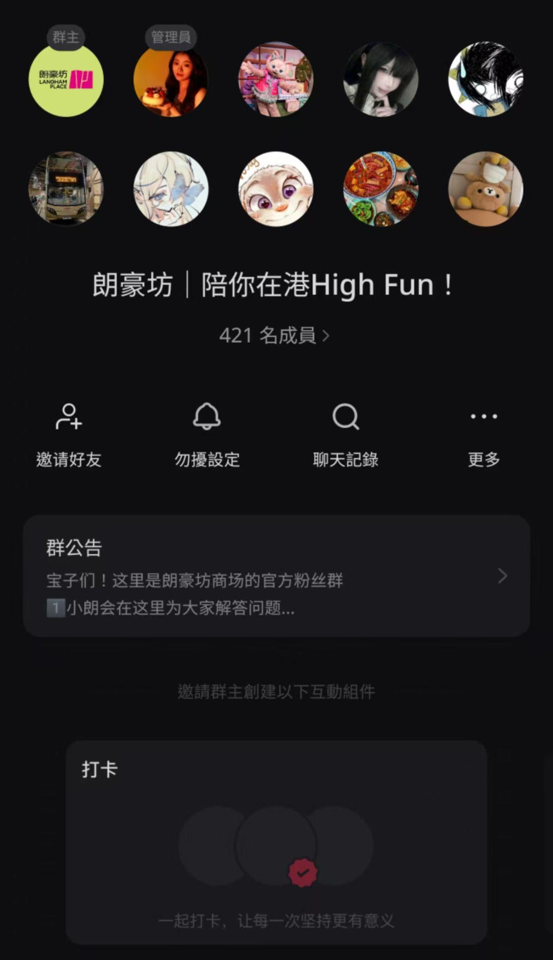
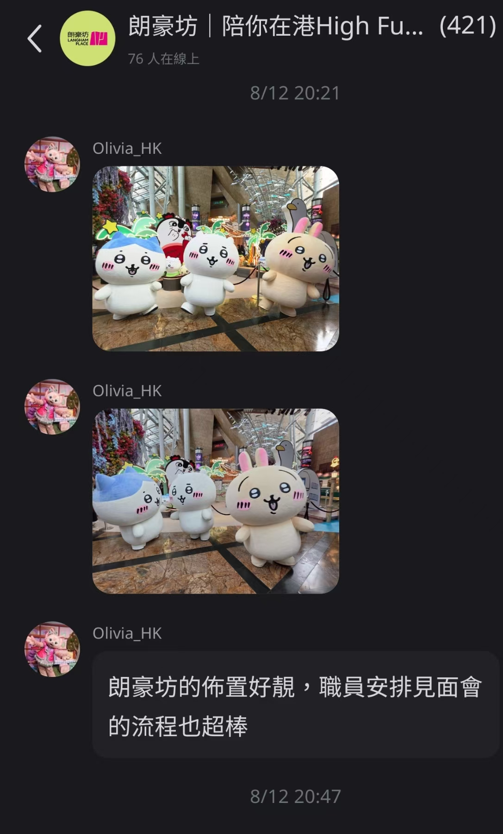
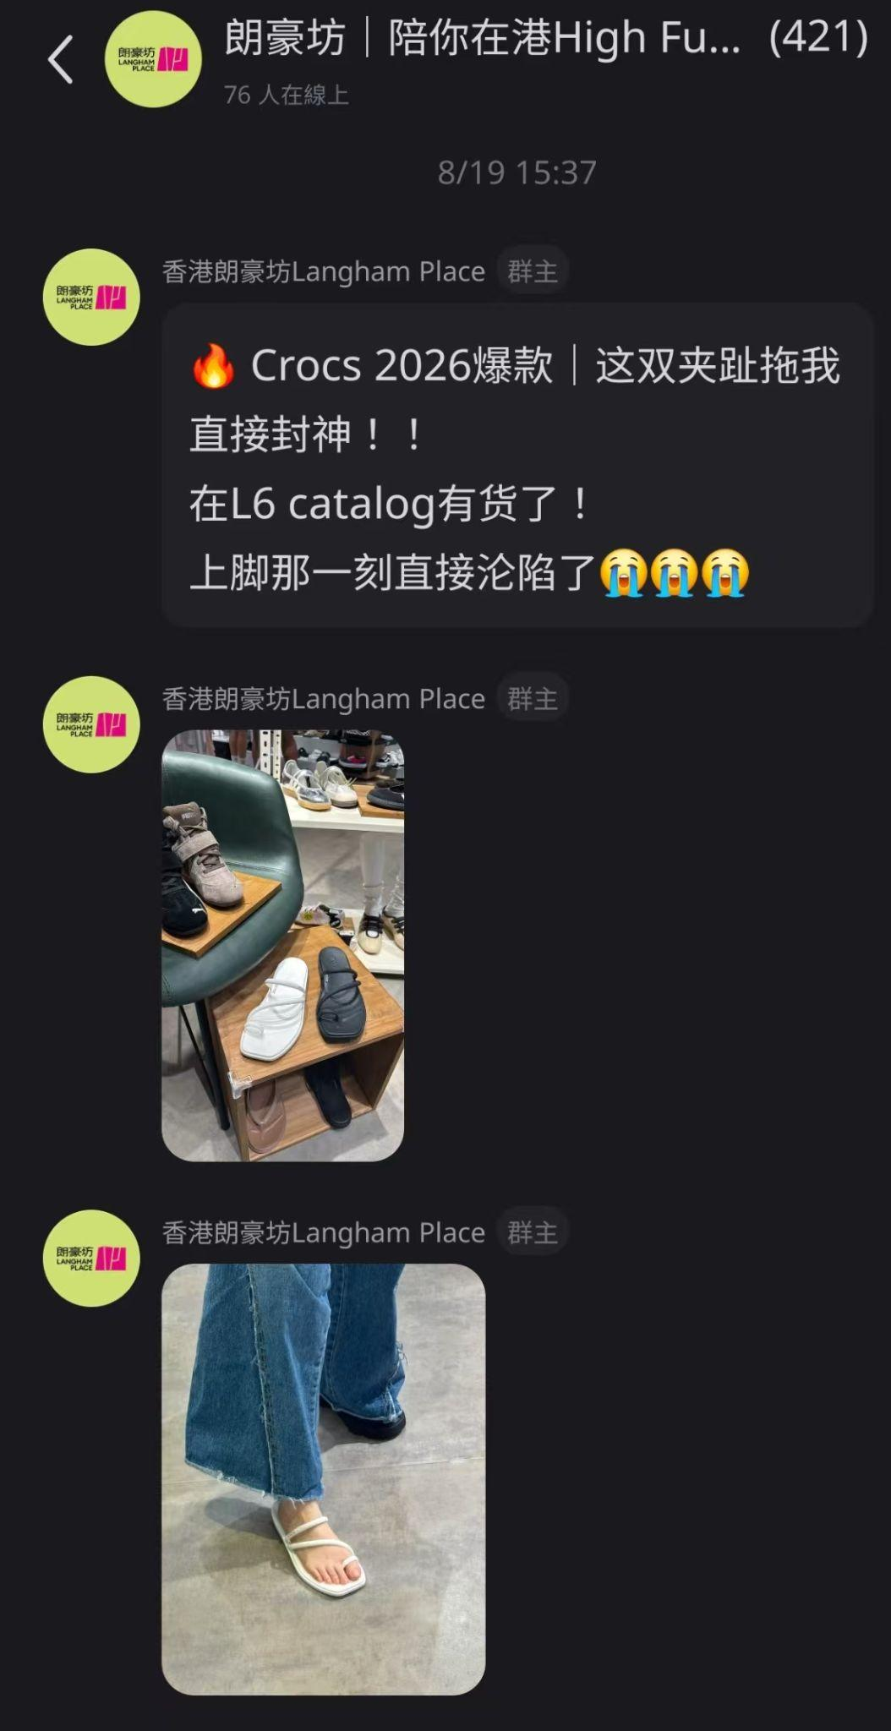
Fans Group Recap
Membership slightly declined in Aug (431→421), mainly due to no fan group activities in the past two months, resulting in natural member churn.
With the new semester starting in Sep and many mainland students arriving, we suggest running a giveaway or offline event to attract new members.
Community Snapshot
Aug: 421 members
IP campaign continued to drive engagement within the group
Always-on updates maintained
Regular new product launches and tenant news shared with members
Screenshot Highlights
Strengthen group-to-UGC conversion
Expand always-on
content variety
This Month's Key Actions
Real-time product inquiry support
01
Provided real-time responses to member inquiries, including pricing, recommendations, and discounts, turning the group into a responsive customer channel.
Note-to-group conversion
02
Maintained ongoing engagement with fans via the group, sharing campaign updates and exclusive news to sustain event buzz and keep the community actively connected.
Always-on content update
03
Continued sharing regular Langham Place updates, including new store launches, fashion, and campaign newss.

Slide 8
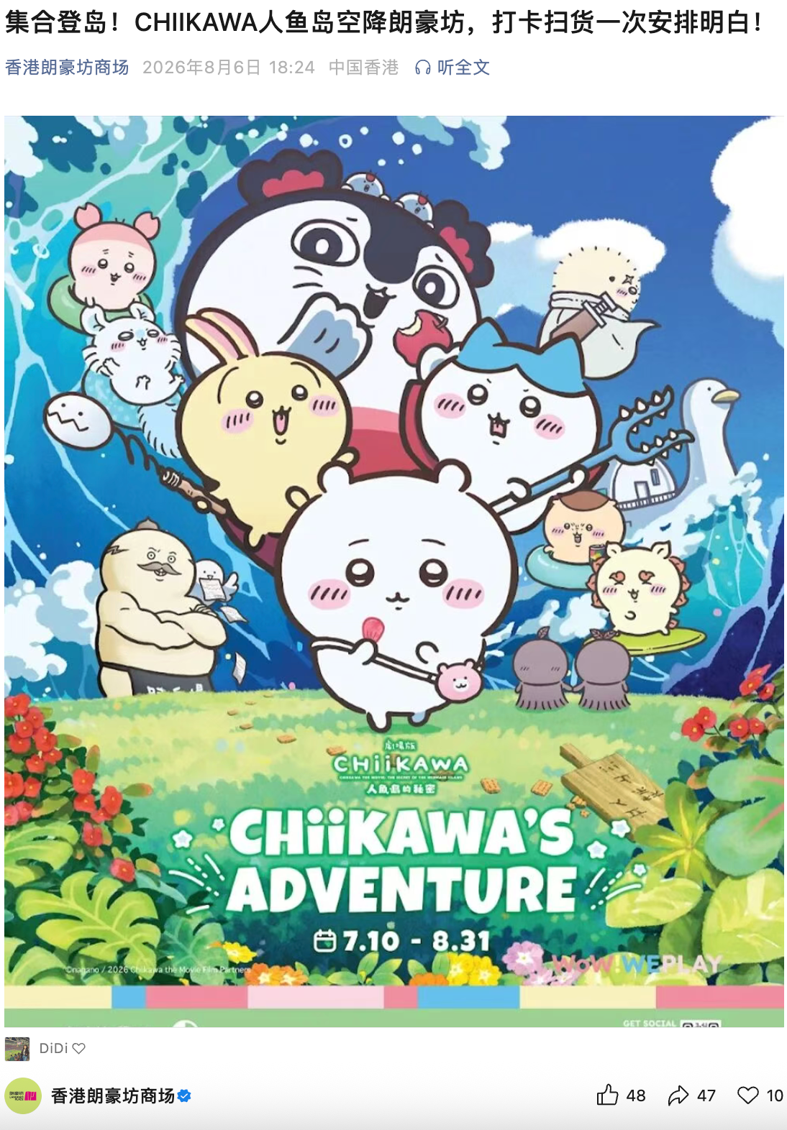
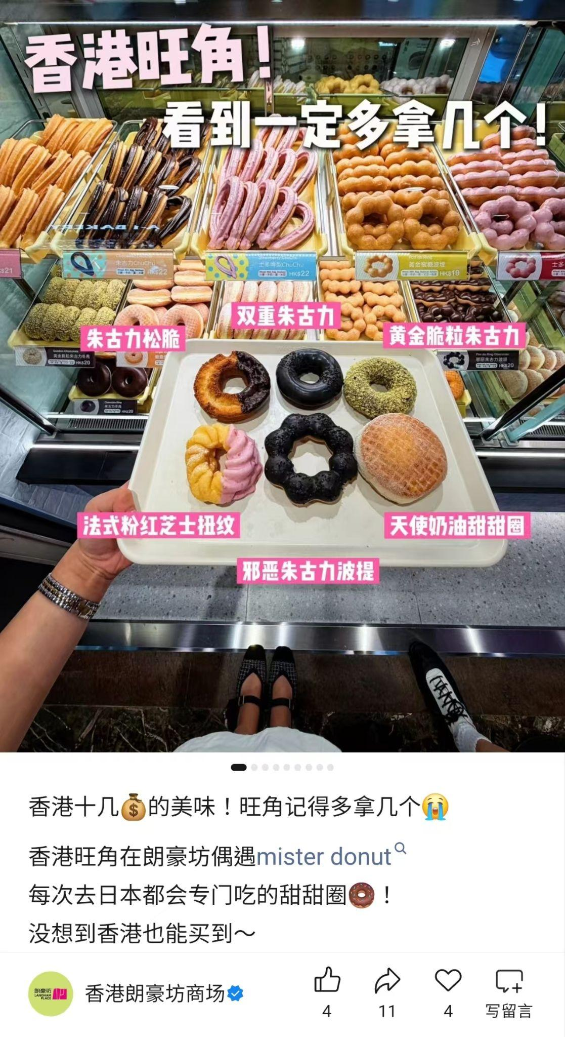
WeChat Performance Summary
We published 3 WeChat posts in Aug. Chiikawa long article drove the highest views and engagement rate.
This month's food post engagement rate (5.05%) outperformed the lifestyle content (accessory) from the previous two months, indicating strong growth potential for food content on WeChat.
Aug vs Jul: Views slightly dropped (1,138→1,041), but engagement rate jumped from 3.78% to 12.49% , driven by Chiikawa IP.
Long article review: Aside from top IPs, long article underperformed regular posts in recent months, reflecting limited audience appetite for long content. We recommend reserving long article only for top IPs and allocating the quota to regular posts.
Wechat Post | Date | Subject | View | Mark | Comment | Like | Share | Total Engagement | Engagement Rate
1 | Aug 6 | 集合登岛！CHIIKAWA人鱼岛空降朗豪坊 | 471 | 10 | 0 | 48 | 47 | 105 | 22.29%
2 | Aug 12 | 香港十几💰的美味！旺角记得多拿几个😭 | 376 | 4 | 0 | 4 | 11 | 19 | 5.05%
3 | Aug 28 | 没人说的港硕开学潜规则😭少流太多泪❗️ | 194 | 1 | 0 | 2 | 3 | 6 | 3.09%
Aug Total |  |  | 1,041 | 15 | 0 | 54 | 61 | 130 | 12.49%
*ENGAGEMENT = MARK + COMMENTS + LIKES + SHARES

Slide 9
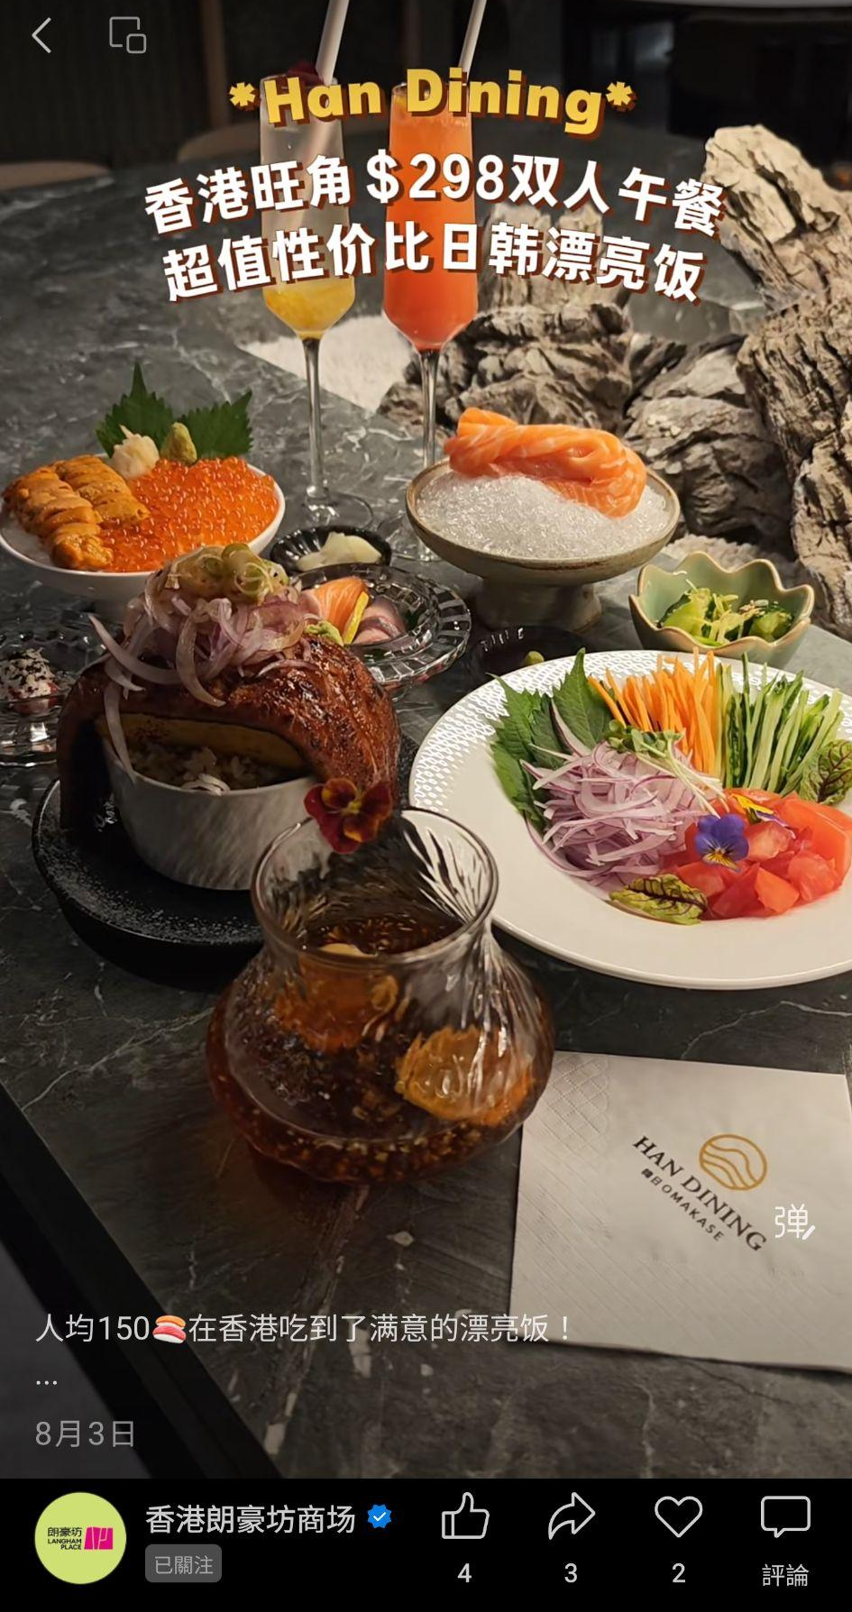
Channel Performance Summary
We released 3 videos on Channel in Aug. Food content drove higher views, but Chiikawa movie guide delivered the highest engagement rate, insicating that IP content on Channel can drives more interaction.
Aug vs Jul: Views slightly increased (+6.5%), but engagement rate slightly declined (0.63% →0.51%).
Both months featured Chiikawa content, but Jul's「活動預熱」「現場突發」 drove stronger interaction, reflecting that event-driven content has greater engagement potential on Channel.
Post | Date | Subject | View | Recommend | Comment | Like | Share | Total Engagement | Engagement Rate
1 | Aug 3 | 人均150🍣在香港吃到了满意的漂亮饭！ | 4,333 | 2 | 0 | 4 | 3 | 9 | 0.21%
2 | Aug 7 | 60s教你来香港看chiikawa大电影 附路线❗️ | 3,839 | 3 | 3 | 12 | 23 | 41 | 1.07%
3 | Aug 20 | 30s看在香港花的zui满意的几笔💰 | 3,667 | 14 | 0 | 8 | 3 | 25 | 0.68%
Aug Total |  |  | 11,839 | 19 | 3 | 24 | 29 | 75 | 0.63%
*ENGAGEMENT = MARK + COMMENTS + LIKES + SHARES

Slide 10
Channel Boosting Performance
In Aug, we boosted 5 videos for RMB 253.2, generating 9,484 views and 15 engagements.
Food content performed the highest views (4,033), the other lifestyle content "30s在香港" shopping content delivered highest engagement (10) with two boosting.
Aug vs Jul: Views slightly down (10,172→9,484) with similar spend, indicating stable boosting efficiency for lifestyle content.
Subject | Period | Objectives | Cost￥ | View | Likes | Recommend | Comment | Share | Follow | Engagement
人均150🍣在香港吃到了满意的漂亮饭！ | 08/12 | Impressions | ￥50 | 4033 | 1 | 1 | 0 | 1 | 0 | 3
60s教你来香港看chiikawa大电影 附路线 | 08/13 | Impressions | ￥50 | 1456 | 0 | 0 | 0 | 0 | 0 | 0
60s教你来香港看chiikawa大电影 附路线 | 08/13 | Impressions | ￥50 | 1948 | 2 | 0 | 0 | 0 | 0 | 2
30s看在香港花的zui满意的几笔💰 | 08/31 | Impressions | ￥51.6 | 1813 | 2 | 8 | 0 | 0 | 0 | 10
30s看在香港花的zui满意的几笔💰 | 08/31 | Impressions | ￥51.6 | 234 | 10 | 0 | 0 | 0 | 0 | 10
Aug Total |  |  | ￥253.2 | 9,484 | 15 | 9 | 0 | 1 | 0 | 25
*ENGAGEMENT = MARK + COMMENTS + LIKES + SHARES

Slide 11
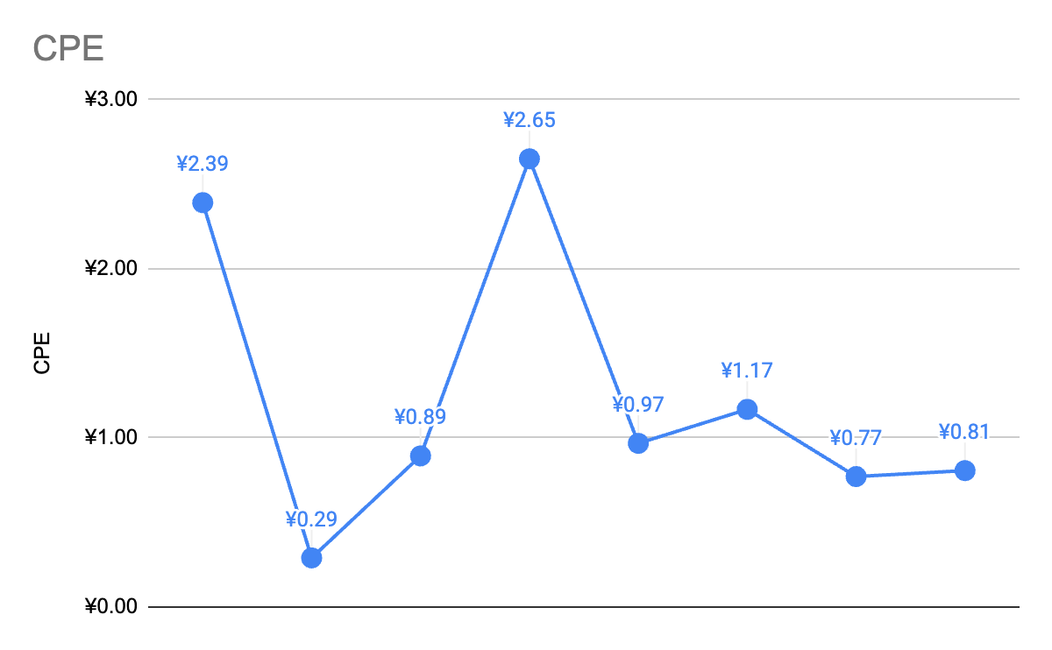
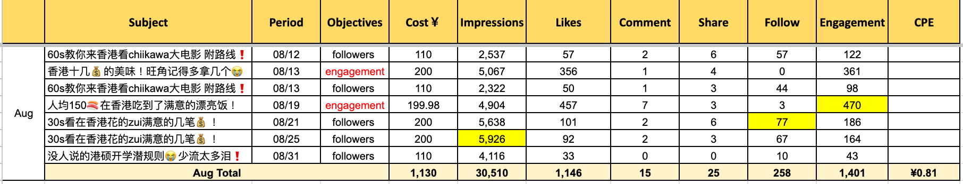
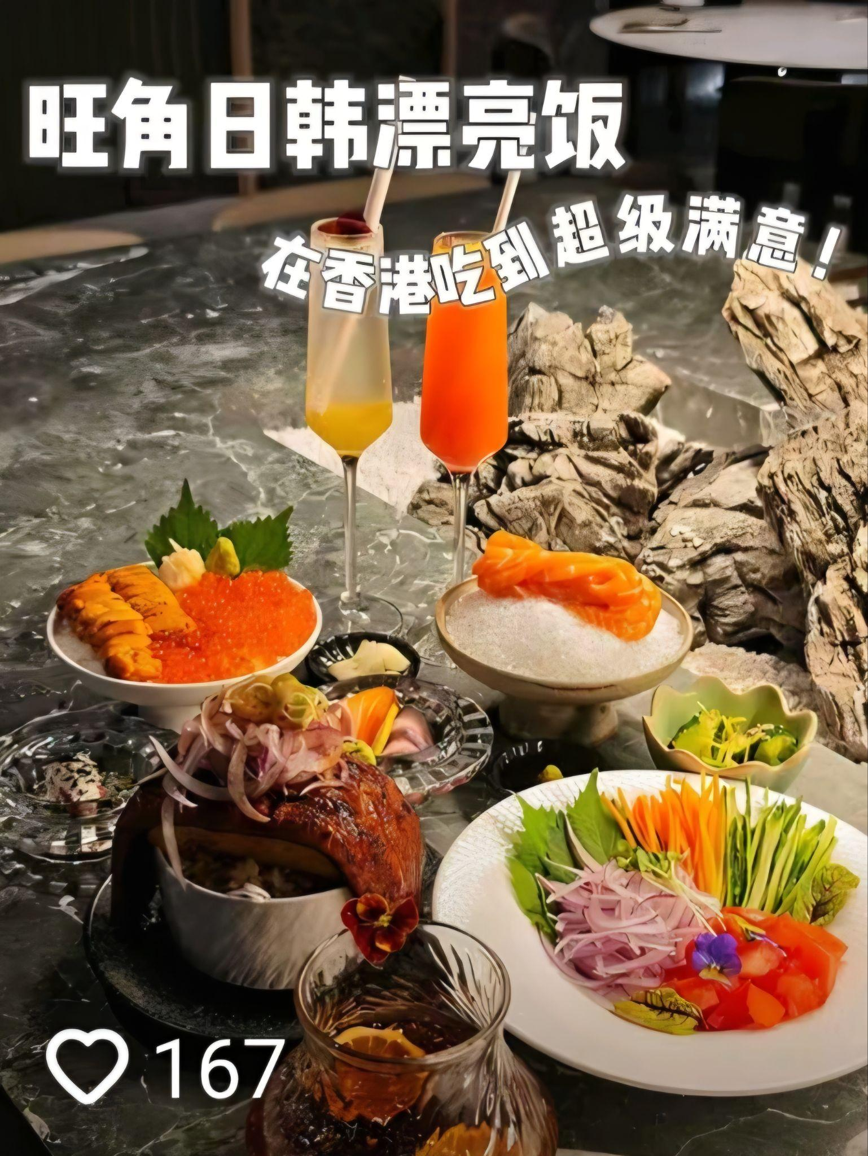
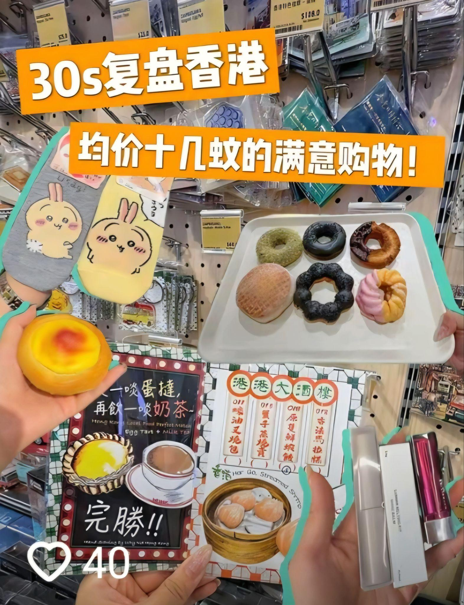
Douyin Performance Summary
4 videos published in Aug. "人均150漂亮飯" recorded the highest views (8,949).
"香港十幾$的美味" delivered the highest engagement (507) and engagement rate (7.73%).
Boosting highlights: "30s在香港" shopping content led in impressions and follower growth;"人均150漂亮飯" led in engagement.
Aug CPE at ¥0.81, slightly up from Jul (¥0.77) and 2025 benchmark (¥0.65), strategy continues to deliver cost-effective results.
2025 Benchmark ¥0.65
Jan
Feb
Mar
Apr
May
Jun
Jul
Aug
Overall Performance |  | View | Like | Comment | Share | Saved | Total Engagement | Total Engagement Rate
 |  | 20,080 | 687 | 5 | 28 | 121 | 841 | 4.19%
Boosting Performance | Cost | Impressions | Like | Comment | Share | Follow | Total Engagement | CPE (Cost Per Engagement)
 | ￥1,130 | 30,510 | 1,146 | 15 | 25 | 258 | 1,401 | ￥0.81

Slide 12
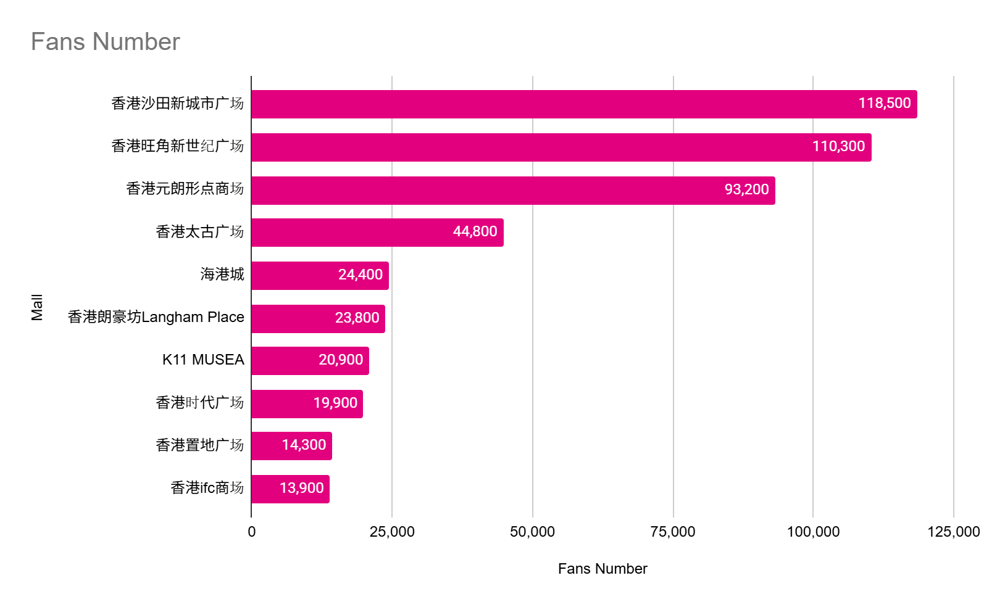
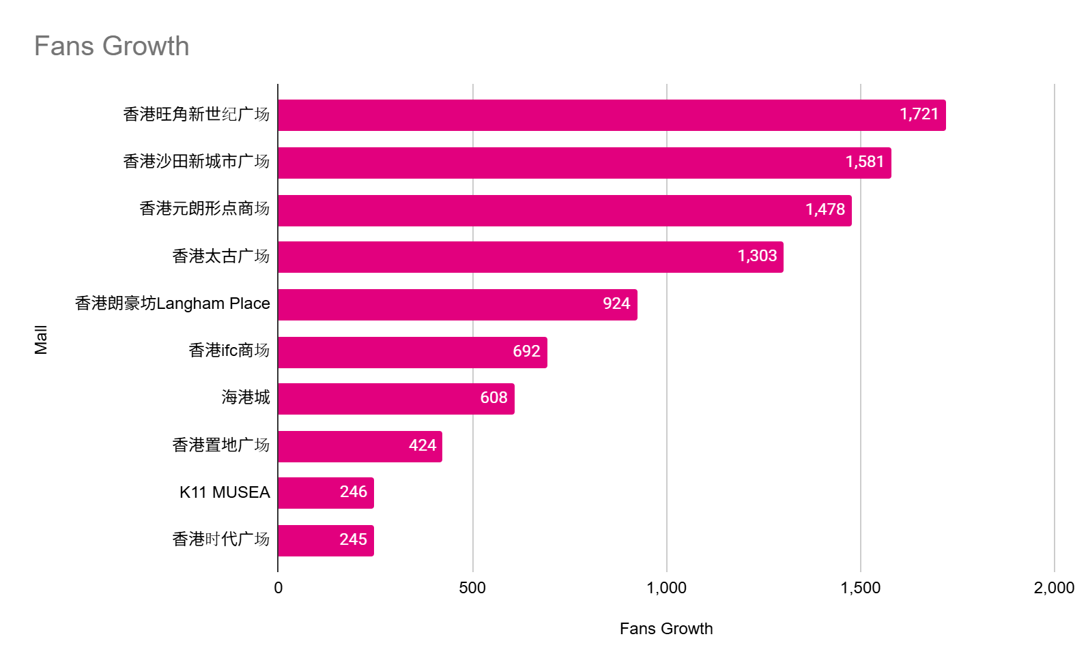
Competitors Analysis- Fan Base
By the end of Aug 2026, Langham Place ranked No.6 position for total fans number.
Ranked No.5 for monthly fans growth across shopping malls, maintaining solid performance on social media.
Source: https://www.huitun.com/
Data range: 2026.8.1 - 8.31

Slide 13
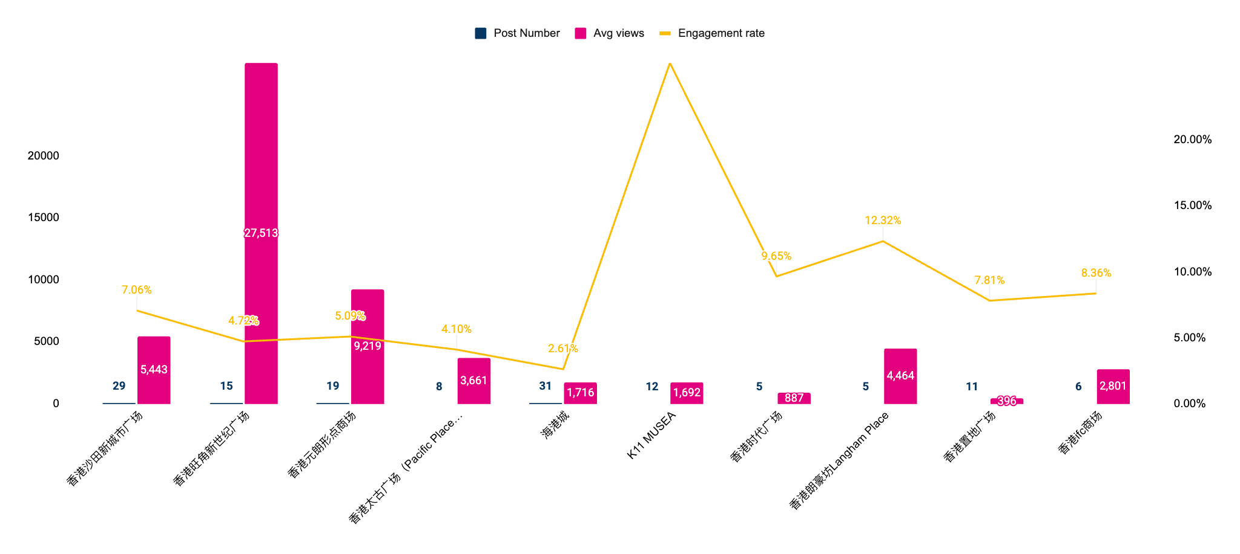
Competitors Analysis- Brand Account Content
In Aug, Harbour City led in post volume with 31 posts, followed by New Town Plaza (29) and YOHO (19).
MOKO recorded the highest average views (27,513), followed by YOHO (9,219).
Langham Place ranked forth in average views and took second‑place in engagement rate at 12.32%, significantly outperforming many peers with higher posting frequency. Our content trategy continues to foster strong audience interaction and resonance.
Source: https://www.huitun.com/
Data range: 2026.8.1 - 8.31

Slide 14
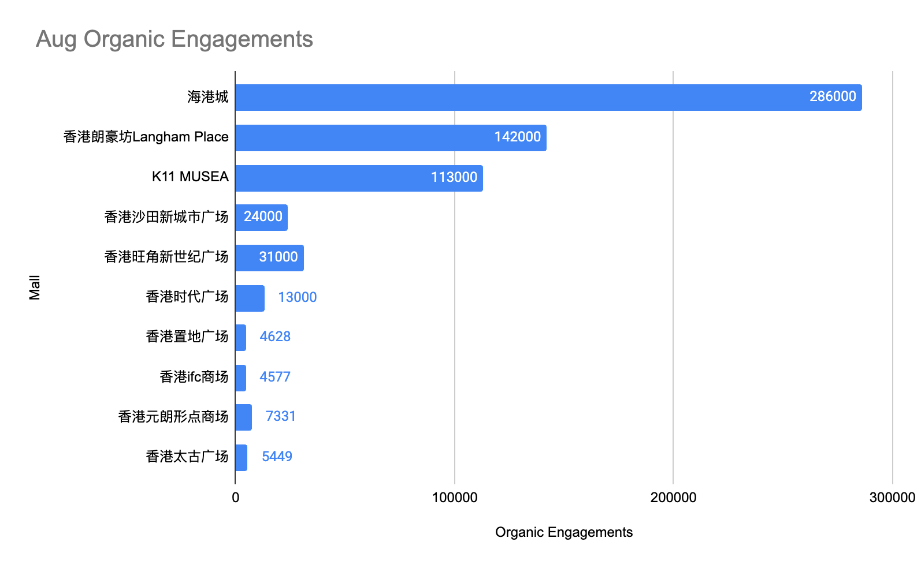
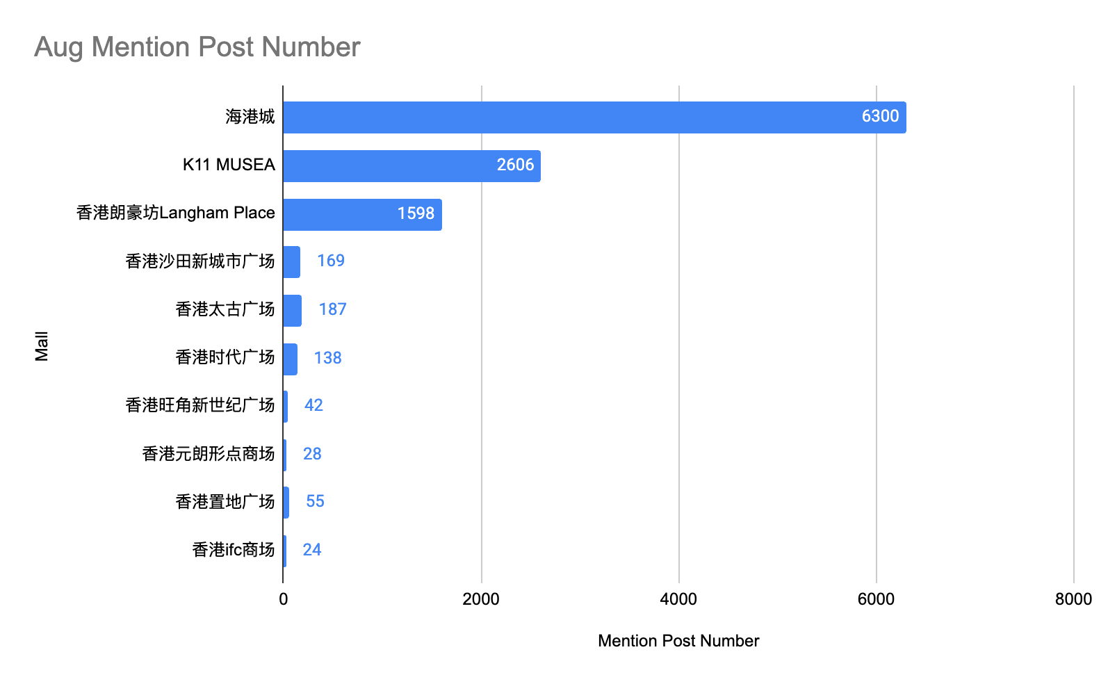
Competitor Organic Traffic Analysis - UGC
In Aug, there were 1,598 posts mentioning Langham Place, generating 142K organic engagements.
Compared to Jul, mention post volume grew 12.7% (1,418→1,598) and organic engagements increased 20.3% (118K→142K), reflecting sustained audience-driven momentum.
Among competitors, Langham Place ranked third in post volume but second in organic engagements, consistently outperforming its posting position.
Data range: 2026.8.1 - 8.31
Source: https://www.huitun.com/

Slide 15

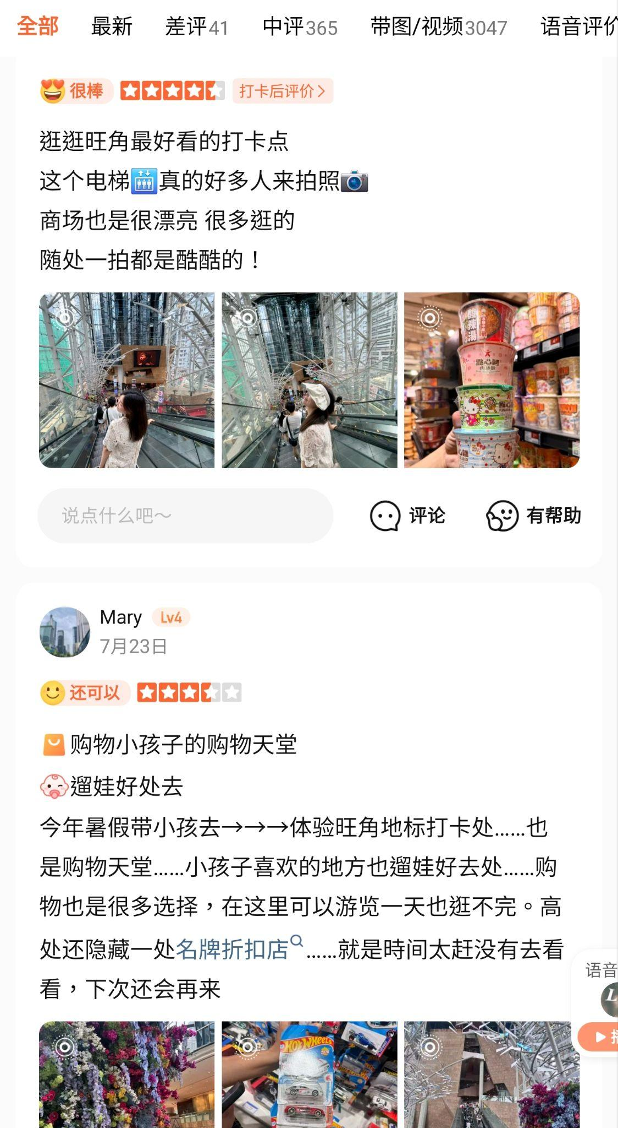
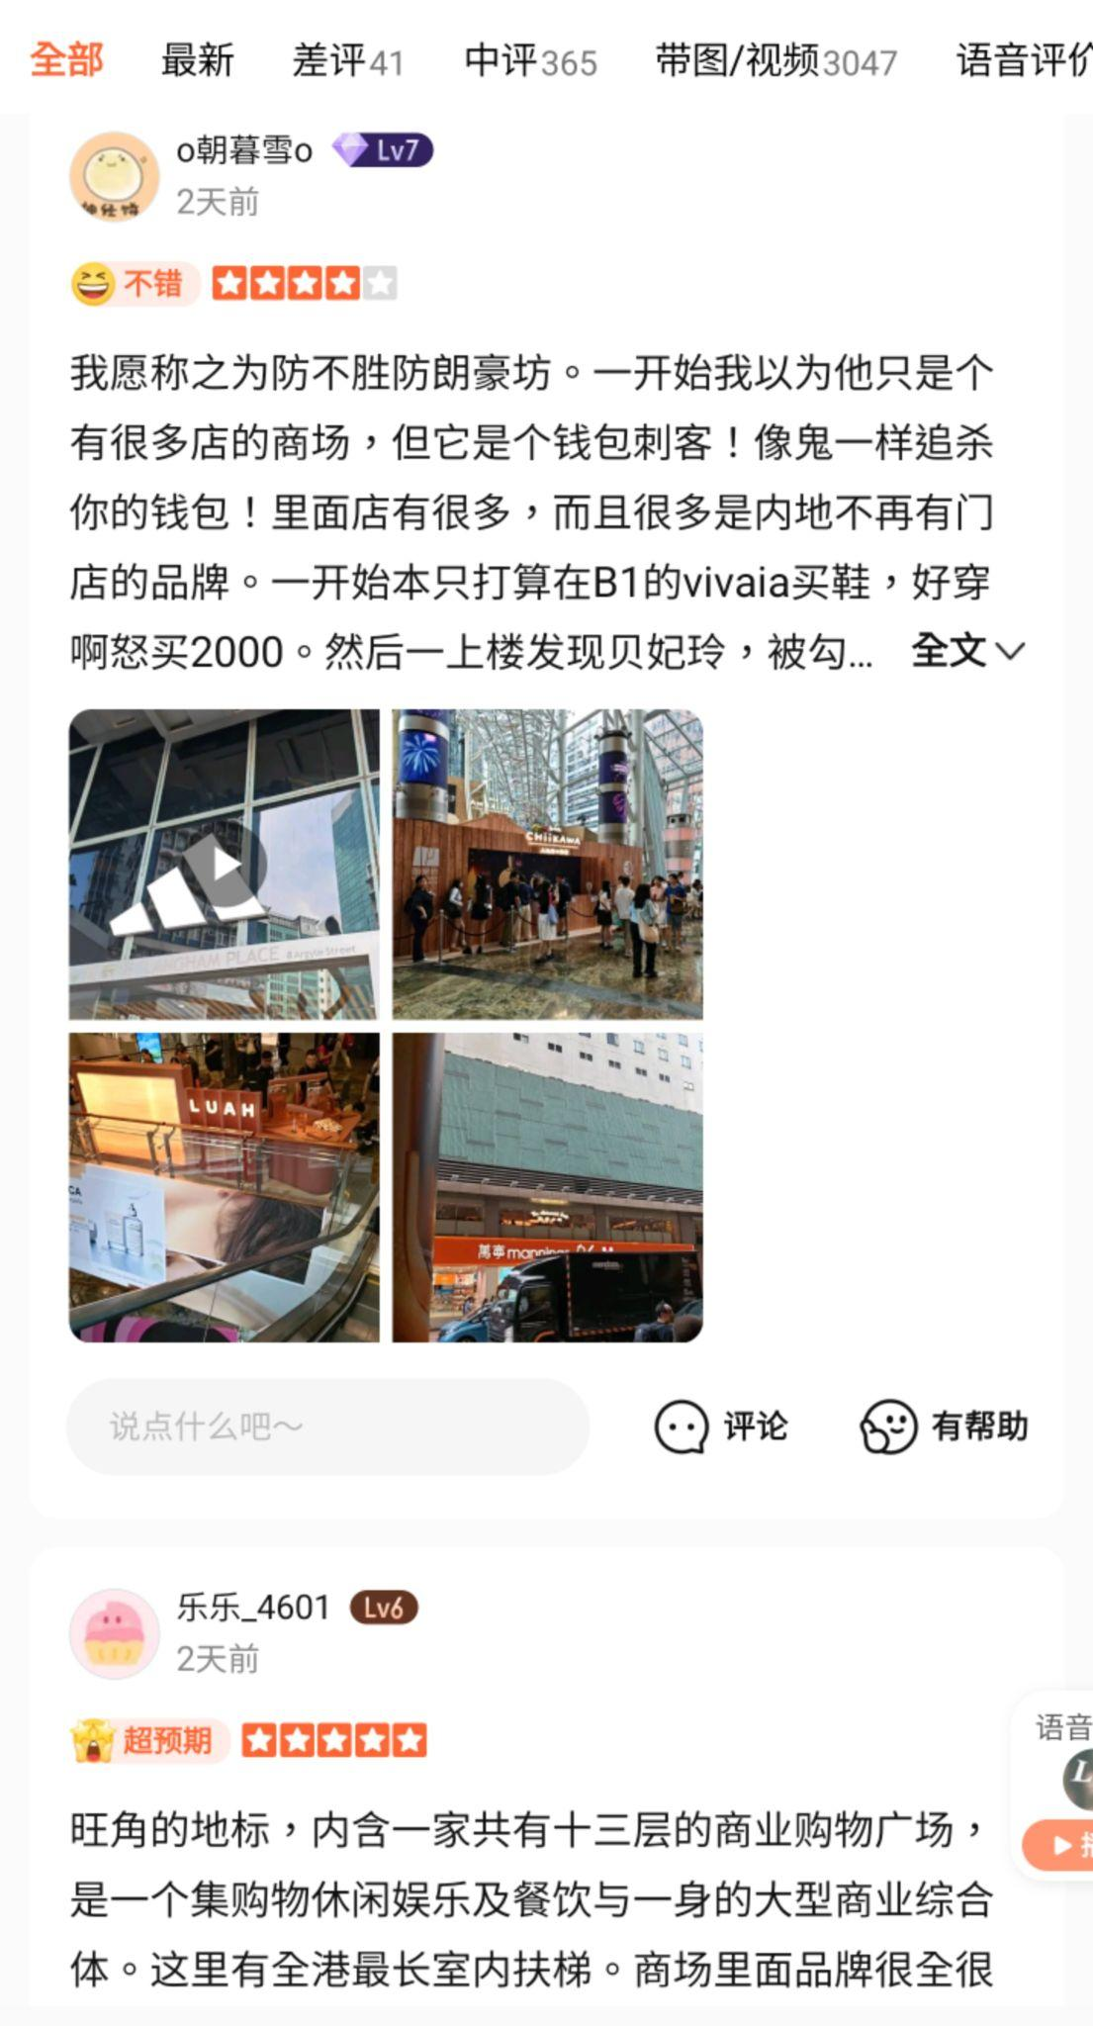
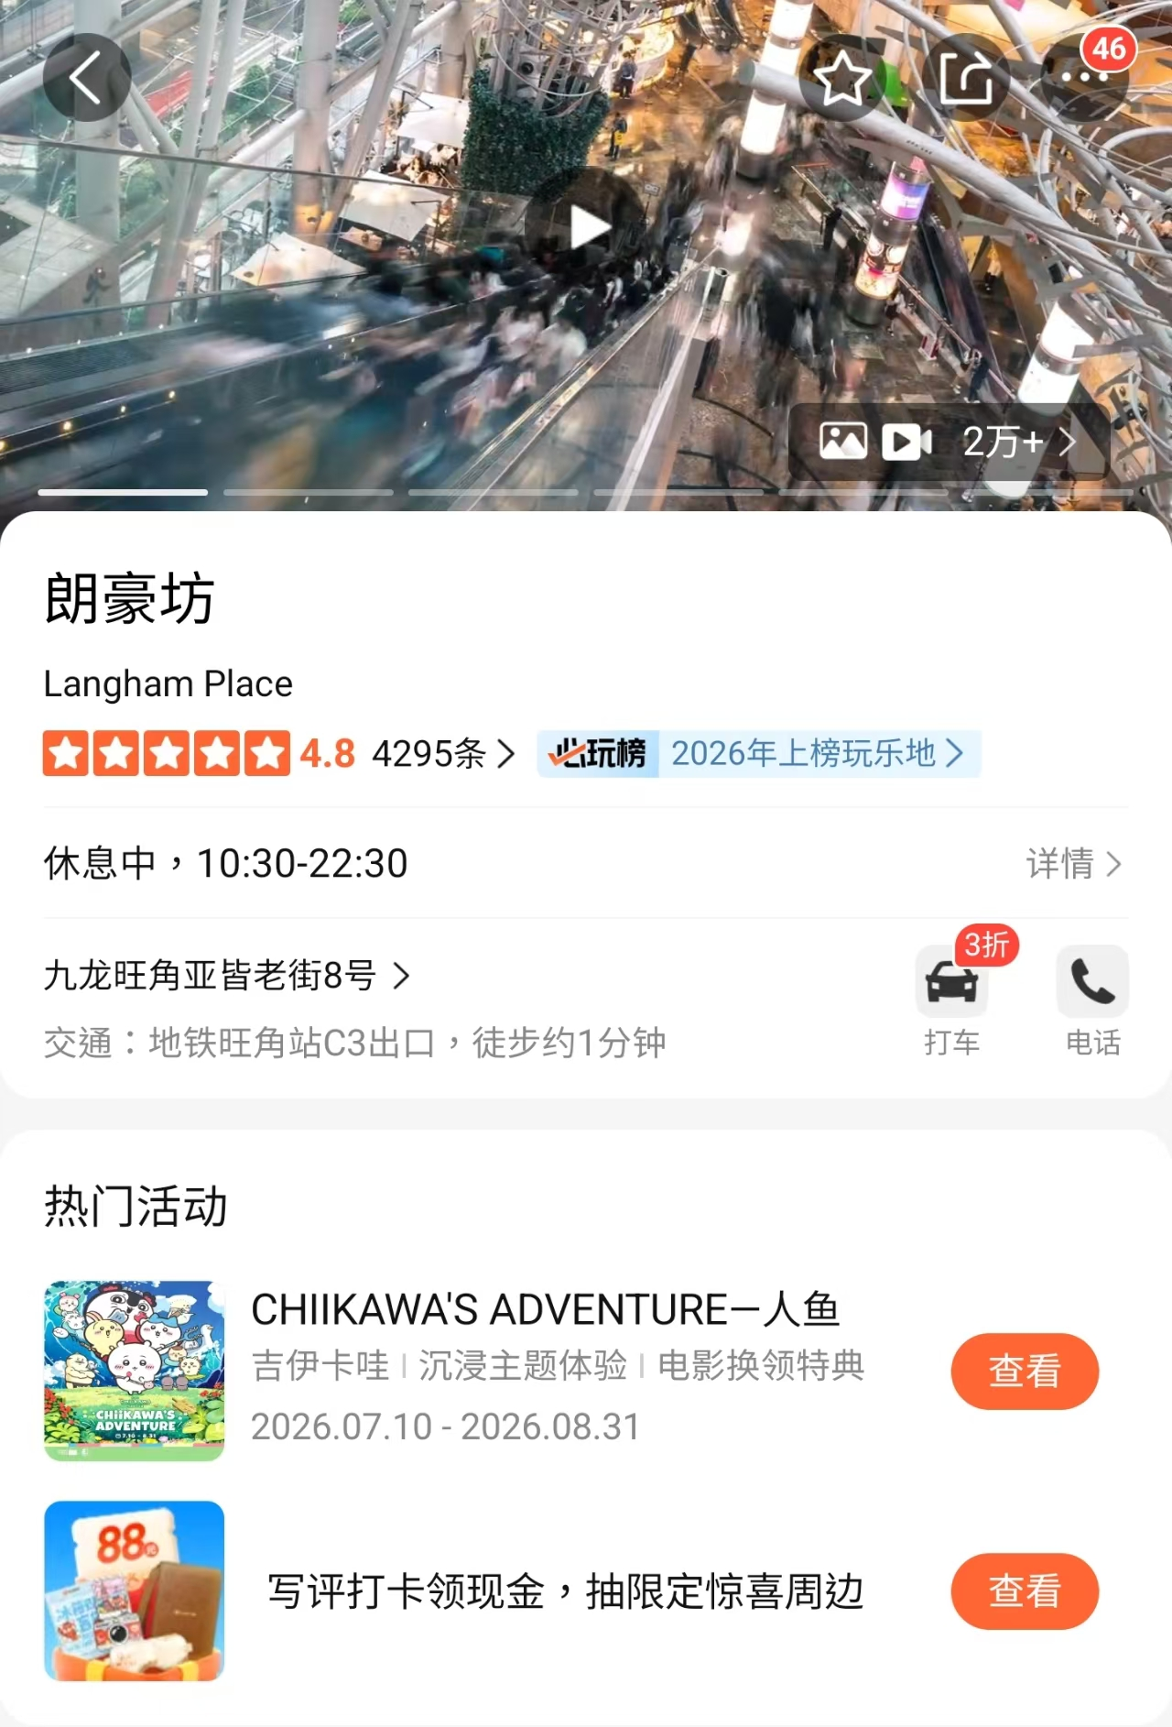
Dianping August Report
In Aug, Dianping recorded 58,322 impressions, 17,909 visits, and 5,106 interested users, all hitting new highs for the year.
Growth was driven by the summer travel season and the Chiikawa IP campaign, attracting mainland tourists to browse the latest event updates and shopping guides, boosting all metrics.
Dianping Performance
Month | Impression | Visits | Interested Users
August | 58,322 | 17,909 | 5,106
July | 52,775 | 14,643 | 4,593
June | 41,362 | 10,868 | 3,385
May | 45,752 | 11,686 | 3,362
April | 40,504 | 9,778 | 2,851
March | 33,380 | 9,150 | 2,737

Slide 16
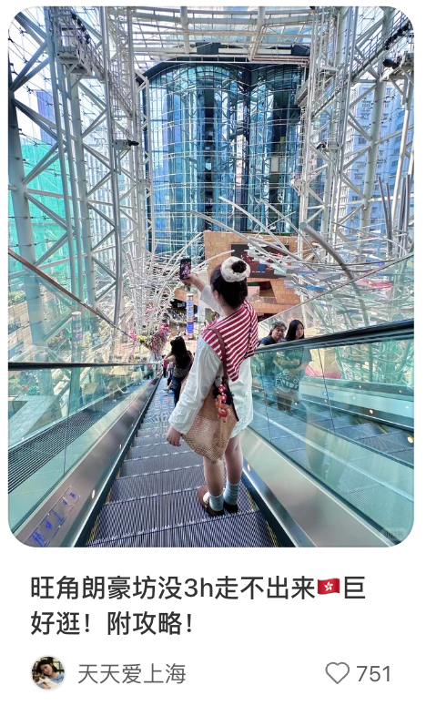
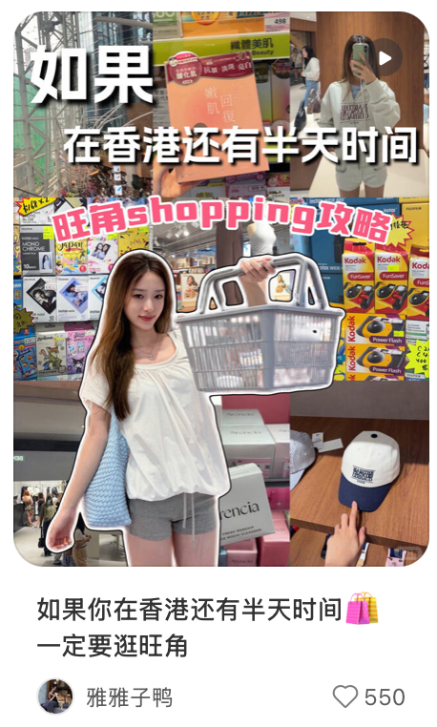
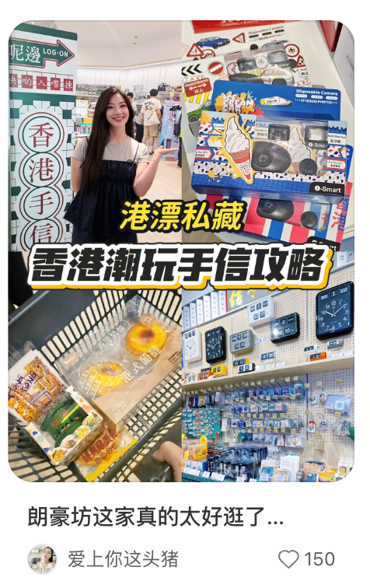
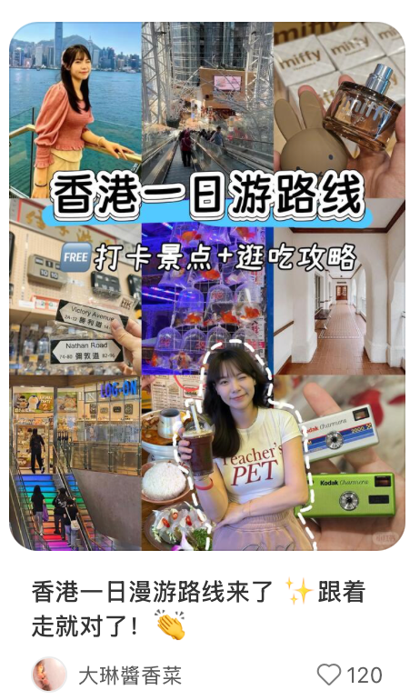
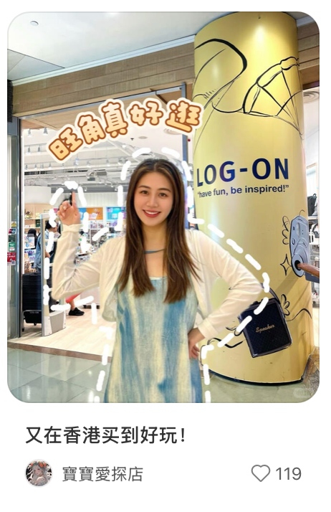
Organic Traffic Analysis- Top 5 Posts
In Aug, Langham Place continued to appear in organic posts such as "shopping guide" and "One-day tours," positioning it as a key hub for shopping and cultural exploration in Mong Kok.
Compared to Jul, Aug posts covered more diverse topics, including "summer shopping discounts," "one-stop shopping," and "cultural strolls," reflecting growing user demand for practical shopping advice and deeper cultural experiences.

Slide 17
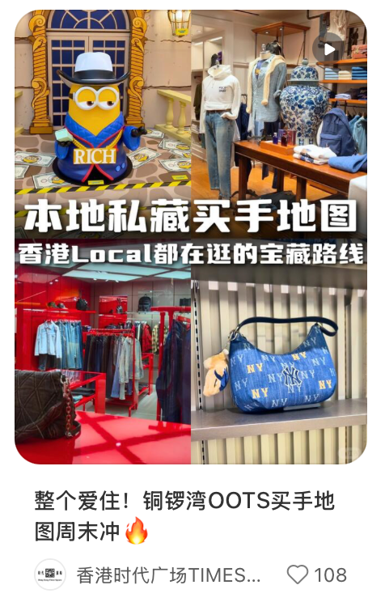
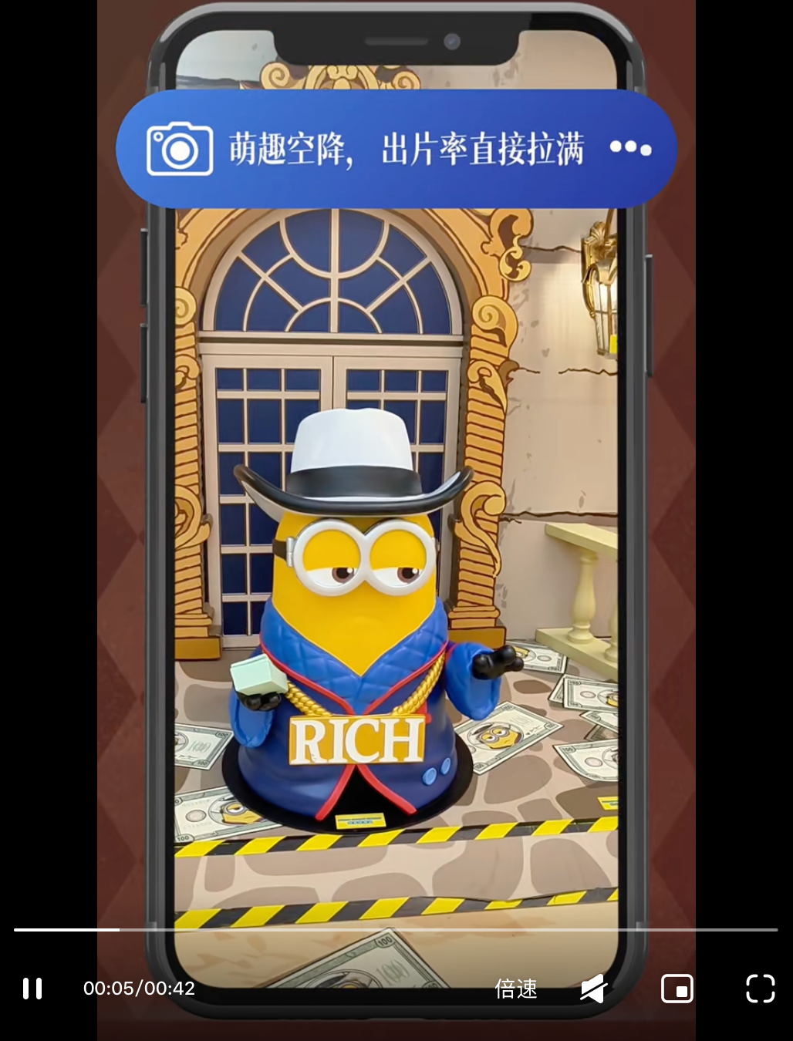
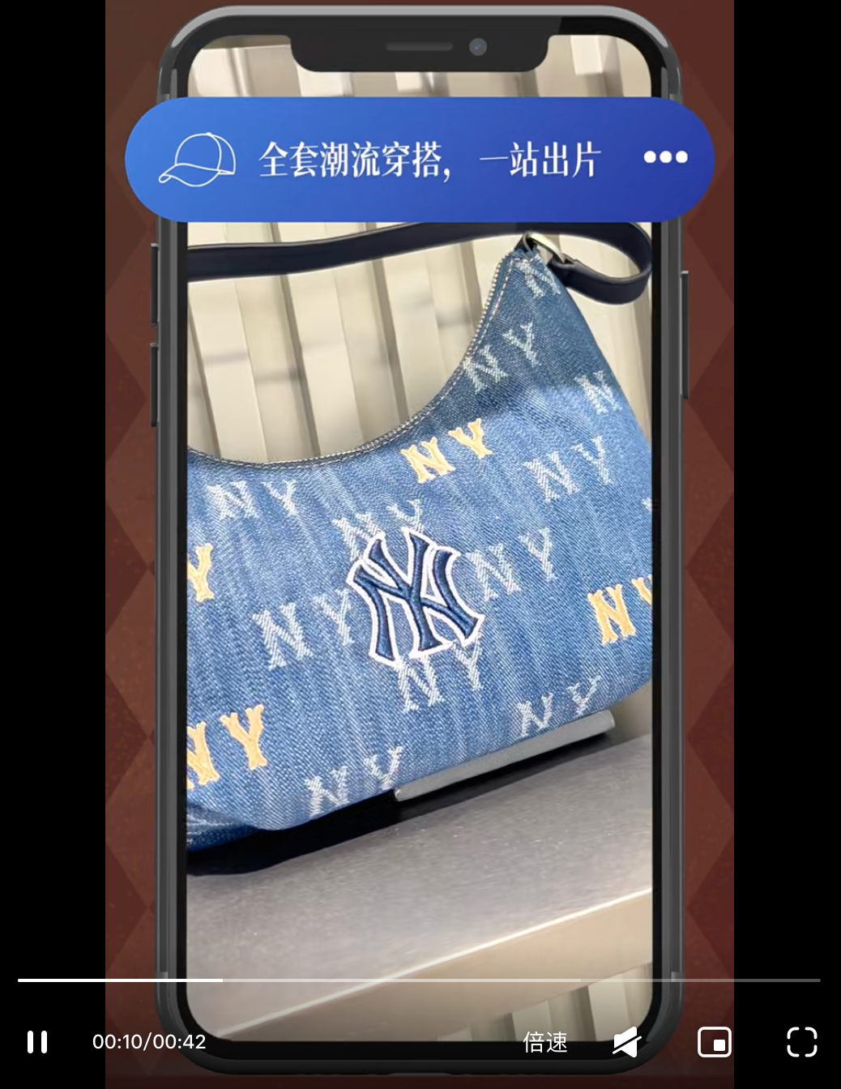
Competitor Content Analysis - Times Square
Topic
OOTS x Buyer‘s Map – Fashion Destination Positioning
Content
Times Square drives engagement via a curated shopping narrative
Visual Hook: Opens with the Minions pop-up to attract foot traffic and encourage check-ins, blending IP appeal with on-site engagement
Curated Shopping Route: Positions Times Square as a Causeway Bay fashion destination, using "OOTS" and "buyer’s map" as key hooks to showcase in-mall brands and street-style vibes
Suggestion: Langham Place can create a similar "shopping route" format, using an IP event or photogenic installation as the visual opener, combined with a curated cross-brand route to drive views and social sharing.
Hashtag
#香港时代广场 #香港购物 #铜锣湾购物 #港真好好逛 #港真好好穿
Link

Slide 18
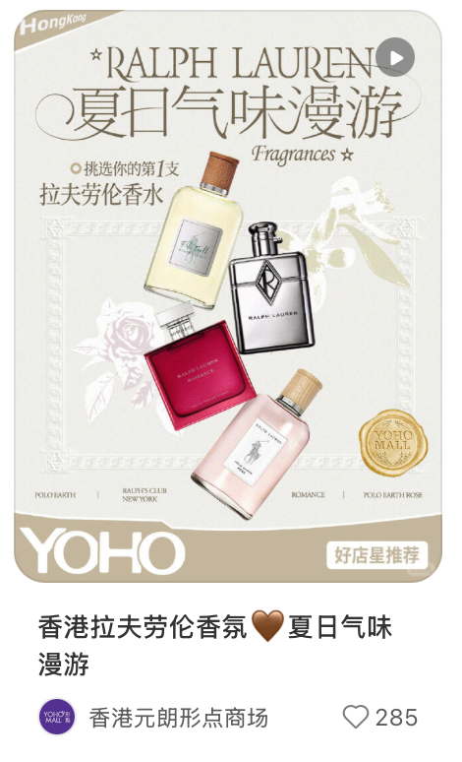
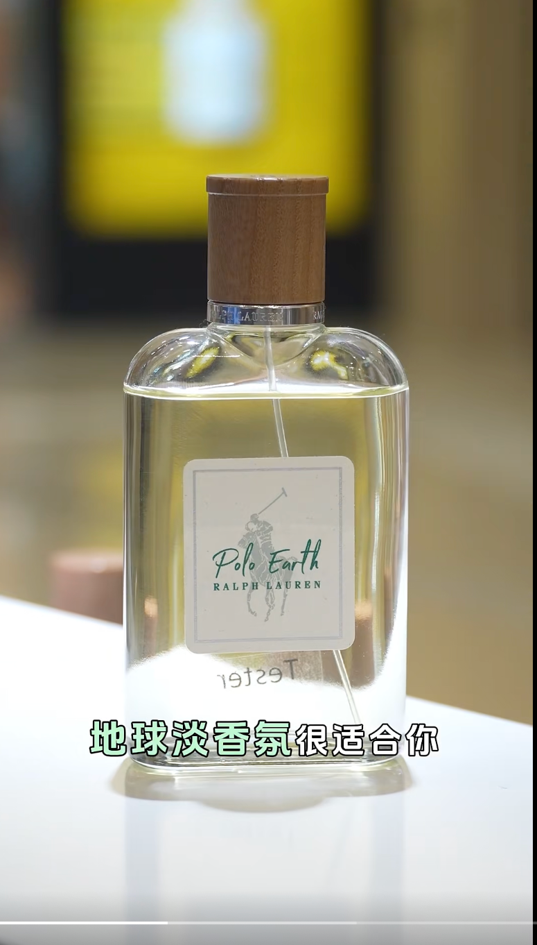
Competitor Content Analysis - YOHO
Topic
Scent Journey – Brand Storytelling through Fragrance
Content
YOHO drives engagement via an immersive brand storytelling approach:
Sensory Hook: Leverages "summer scent journey" as the core concept, curating Ralph Lauren Fragrances' hero products through evocative, lifestyle-driven copy that paints vivid sensory scenes
Lifestyle Curation: Positions the fragrance selection as a "scent journey" rather than a product push, appealing to shoppers seeking gifts or personal treats through free in-store sampling and a "find your signature scent" narrative
Suggestion: Langham Place can adopt this "sensory storytelling" model — curating beauty and lifestyle products through evocative themes (e.g., "autumn skincare ritual") that focus on experience over features, driving engagement and in-store trials.
Link
Hashtag
#YOHOMALL#香港生活 #香港探店 #香港打卡 #元朗好去处 #香港周末游

Slide 19
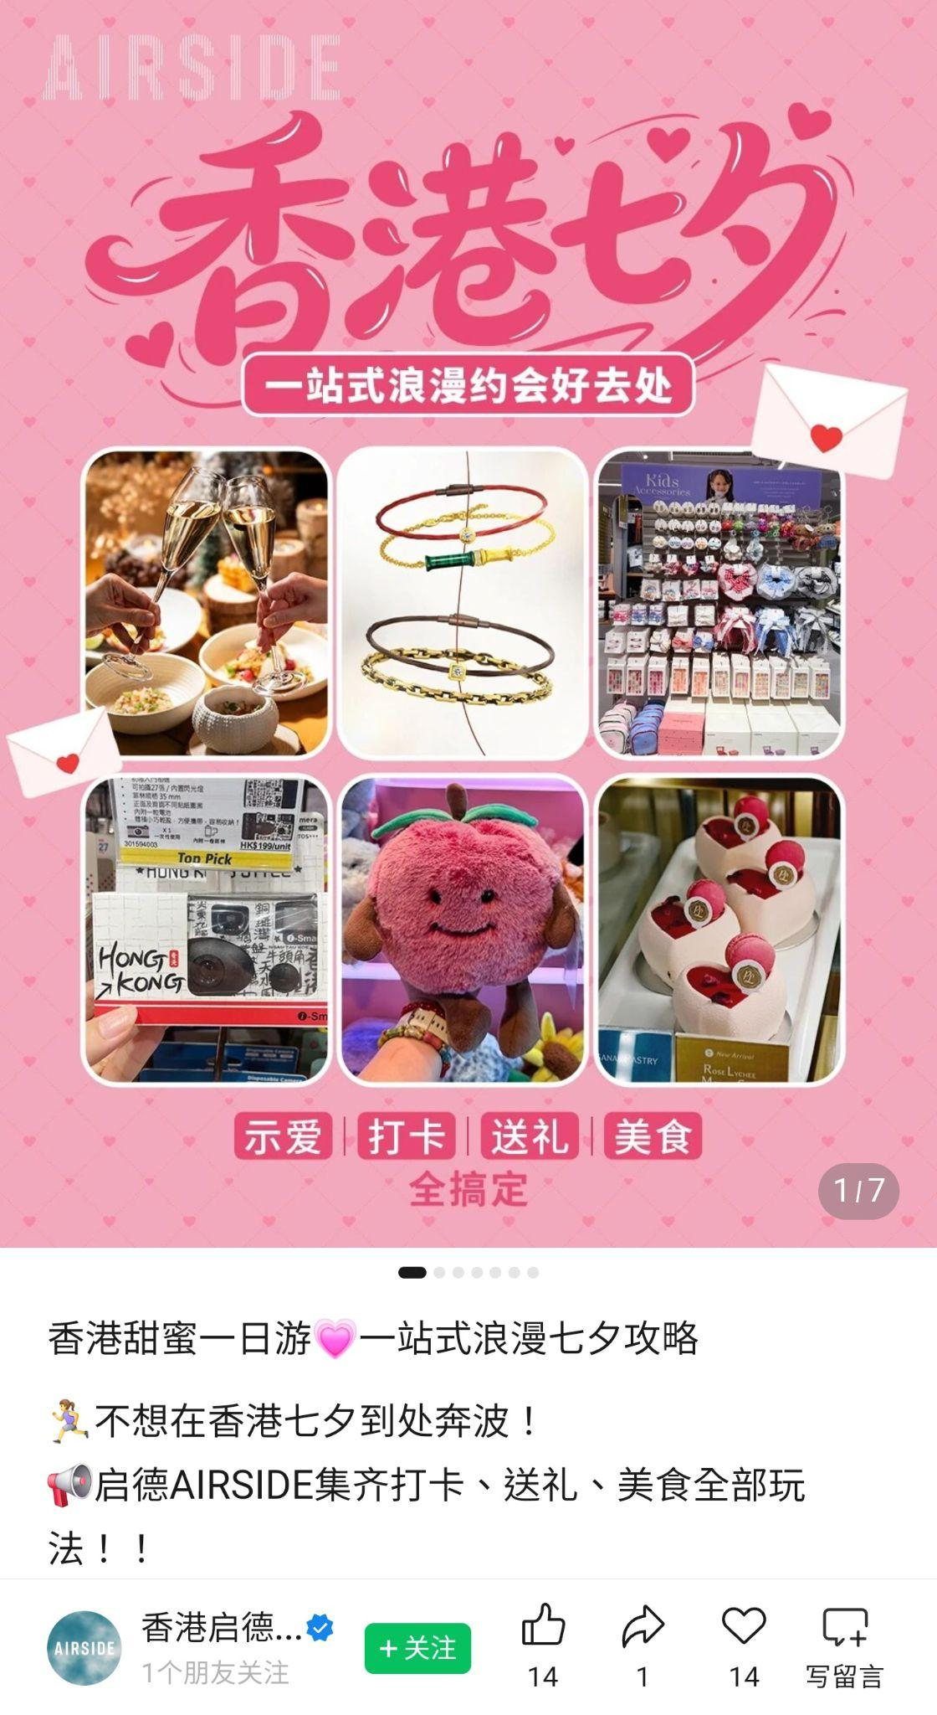
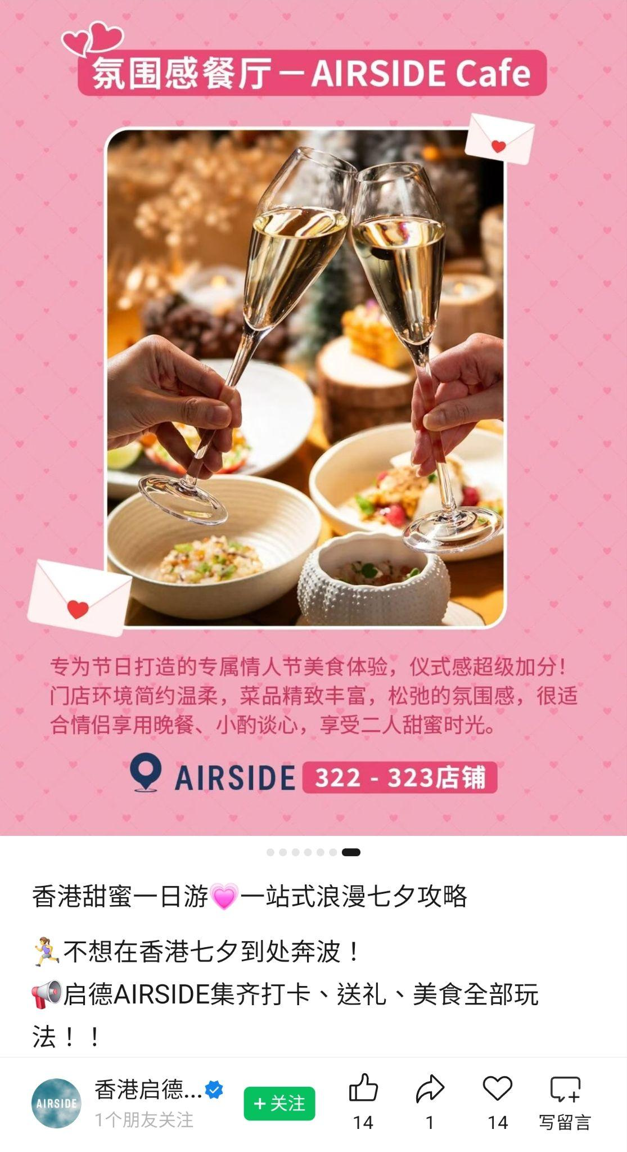
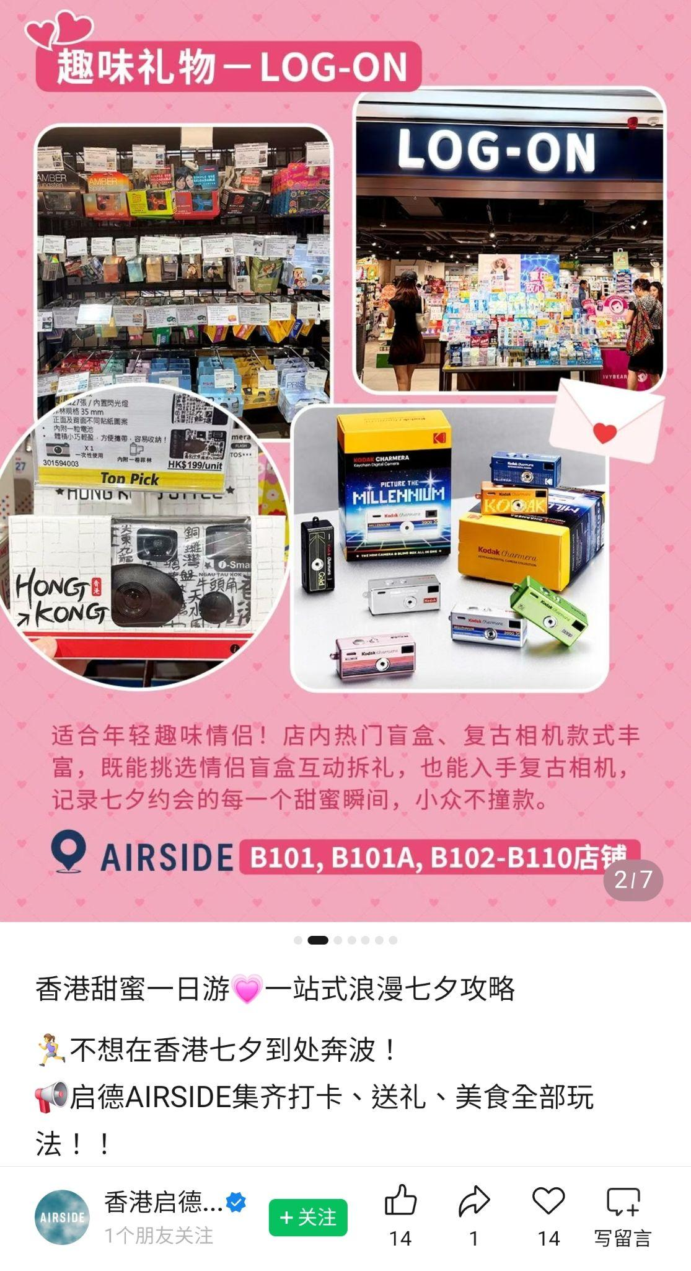
Competitor Content Analysis - AirSide
Topic
Festive One-Stop Guide – Romantic Date Destination
Content
AIRSIDE drives engagement via a curated festival guide
Festive Hook: Positions AIRSIDE as a one-stop romantic date destination for Qixi Festival, using "懶人福音" as a key message to reduce user planning effort
Cross-Category Curation: Curates gift and dining options across budgets (from LOG-ON to 周生生 to 3COINS to AIRSIDE Cafe), simplifying user choice while driving cross-category spending
Suggestion: Langham Place can adopt a similar "festival one-stop guide" format for key occasions (e.g., Christmas, Valentine's Day, Mother's Day), curating gifting and dining options across budgets to position the mall as a go-to celebration destination.
Link

Slide 20
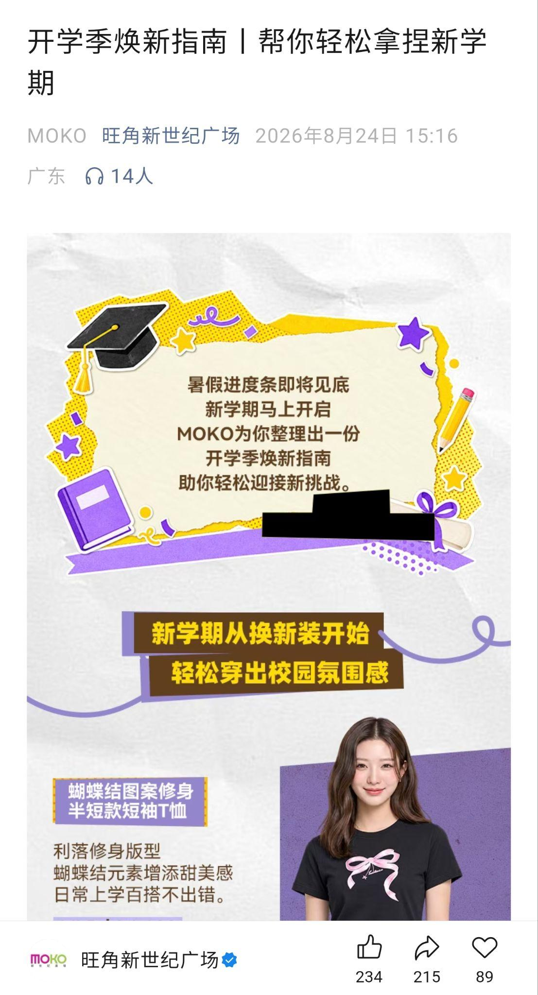
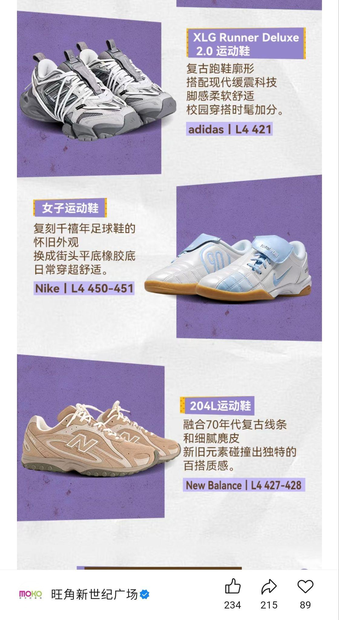
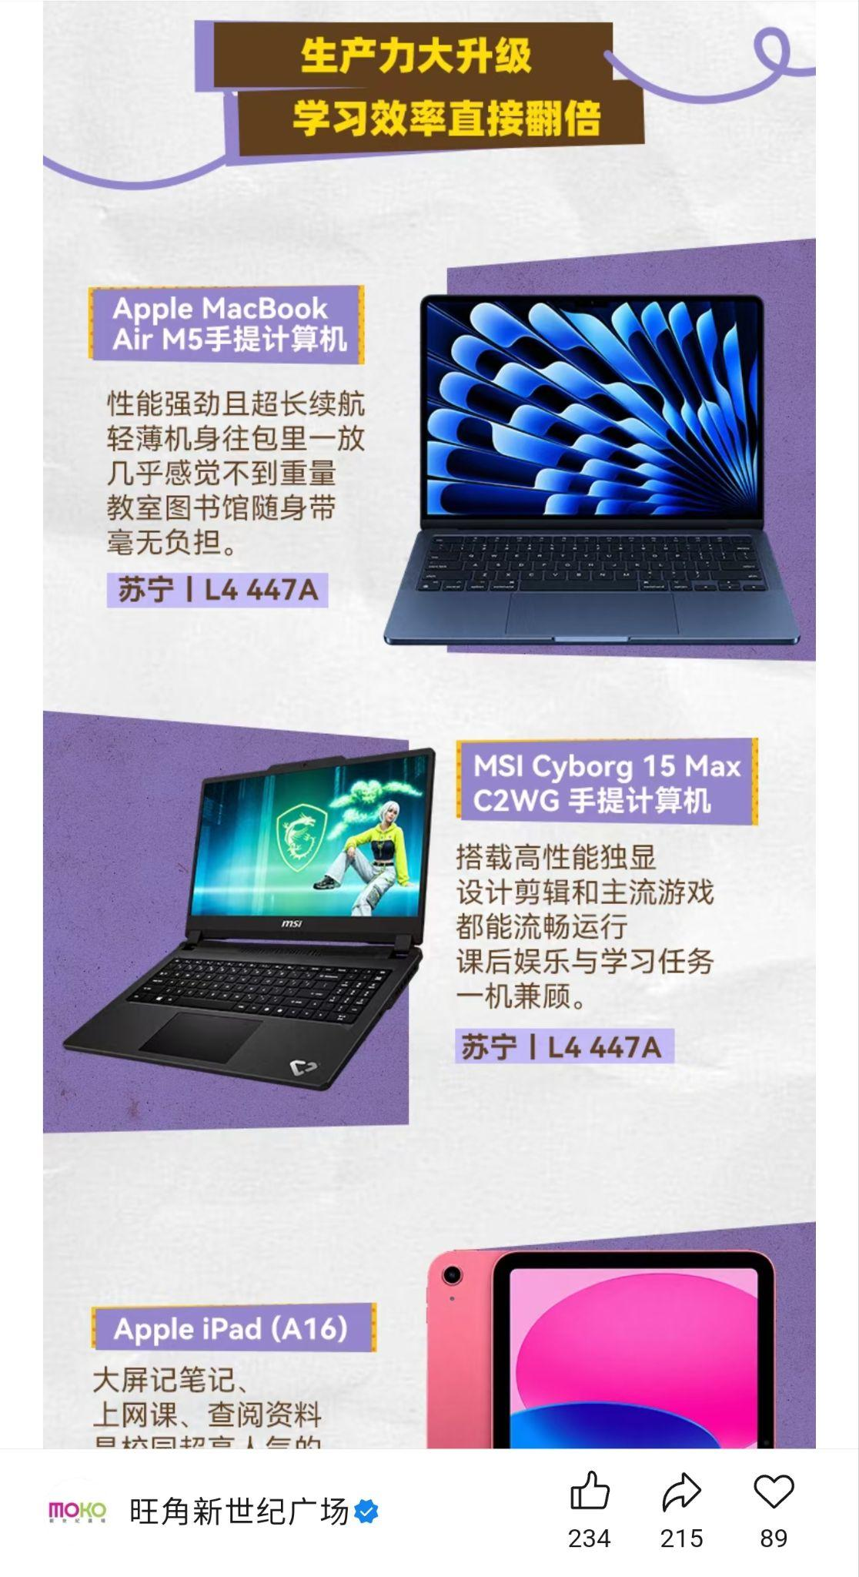
Competitor Content Analysis - MOKO
Topic
Back-to-School One-Stop Guide – Student & Parent Targeting
Content
MOKO drives engagement via a practical seasonal guide
Seasonal Hook: Uses "back-to-school season" to precisely target students and parents, opening with "暑假進度條即將見底" to create urgency and relevance
Category Curation: Curates in-mall fashion, electronics, and stationery tenants into a one-stop shopping guide, with product selections that are practical and student-focused — driving strong save and share intent
Suggestion: Langham Place can explore similar seasonal themes (e.g., "back-to-school essentials" or "internship style guide") and curate cross-category tenant guides with a clear, practical angle to drive engagement and foot traffic from students and parents.
Link

Slide 21
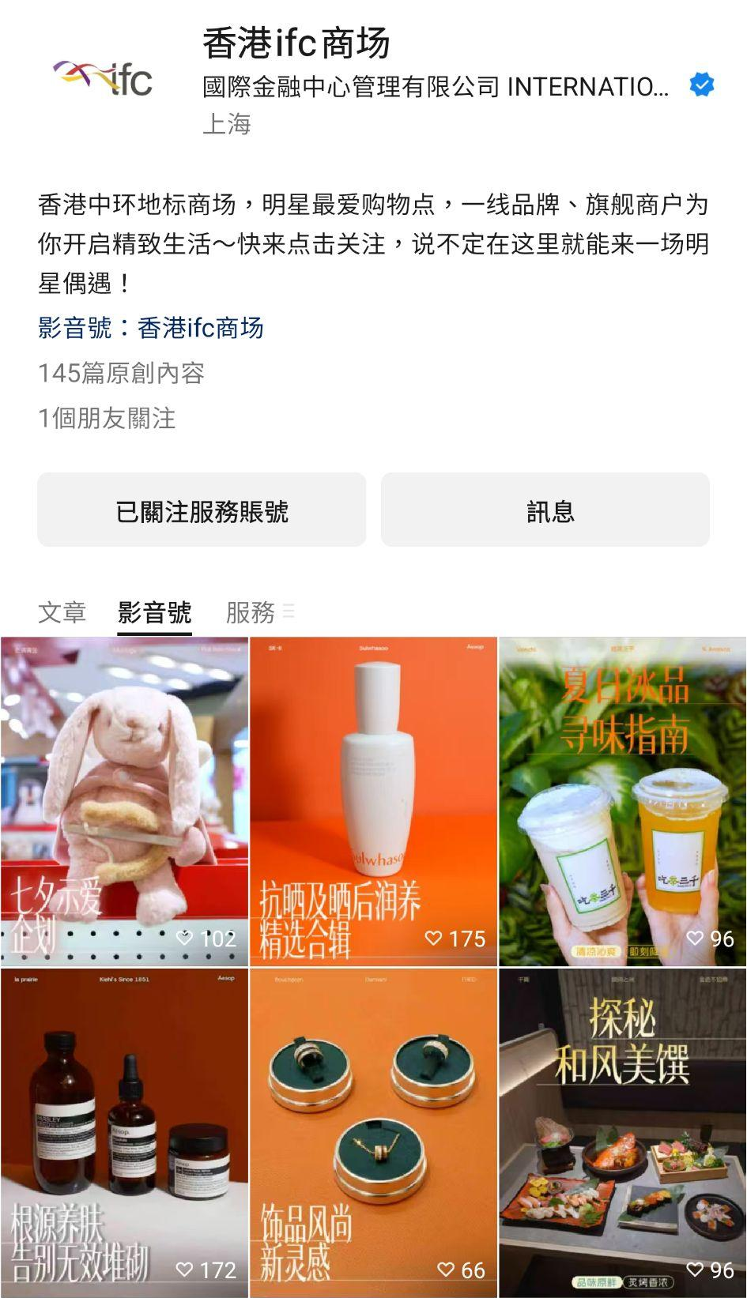
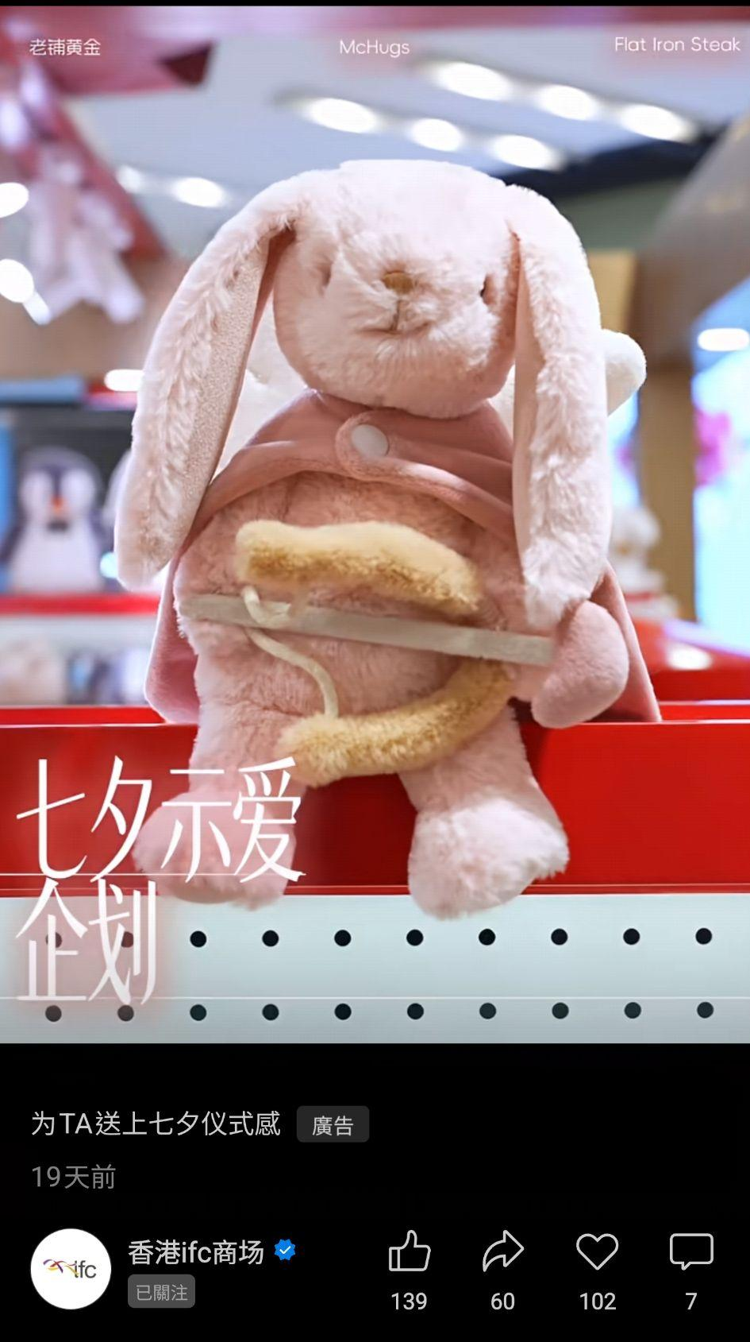
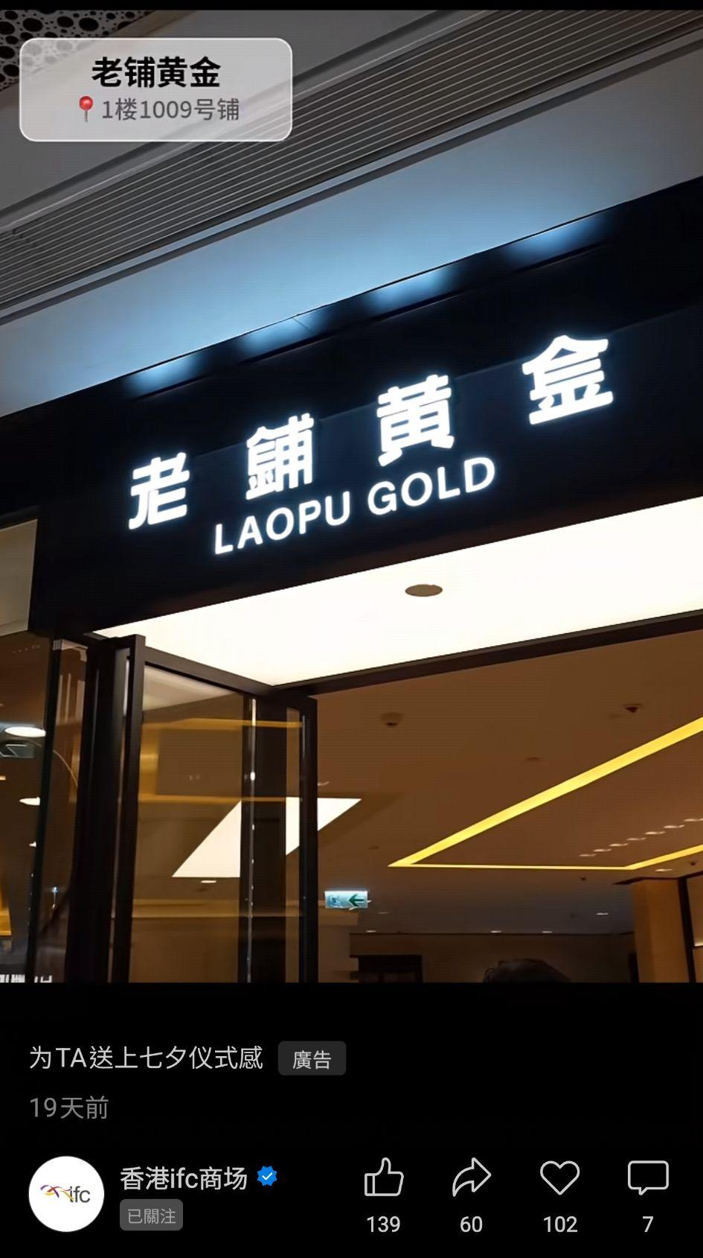
Competitor Content Analysis - IFC
Topic
Festive Gifting – Ritual-Driven Romance
Content
IFC drives engagement via a premium festive narrative:
Emotional Hook: Leverages "Qixi" and "sense of ritual" as the core message, curating premium gifting options (Laopu Gold, McHugs) to position IFC as a luxury date destination
High-End Curation: Turns festival gifting into an elegant, high-end experience, attracting sophisticated couples seeking meaningful celebrations without compromising on quality
Suggestion: Suggestion: Langham Place can explore a similar "premium gifting" angle for key festivals — curating a selection of high-end jewellery, beauty, and lifestyle brands under a "sense of ritual" theme to attract discerning consumers.
Link

Slide 22
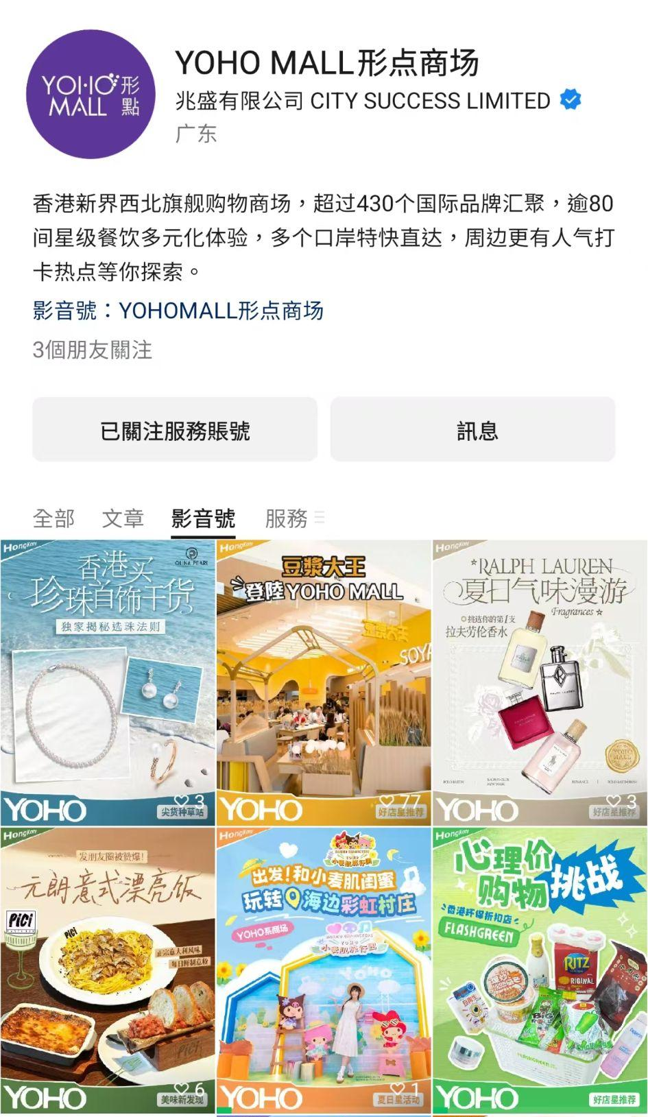
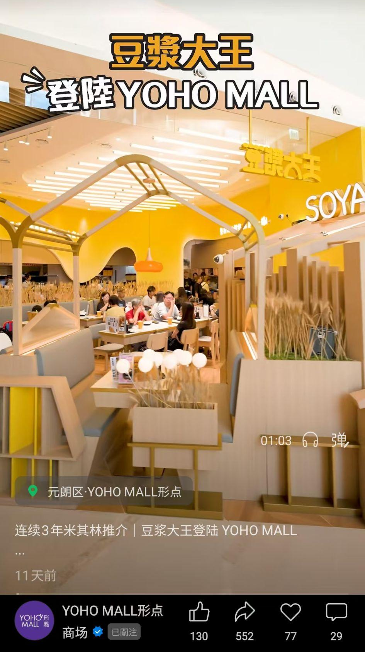
Competitor Content Analysis - YOHO
Topic
New Store Launch – F&B
Content
YOHO drives engagement via a brand-story-driven F&B launch
Credibility Hook: Leverages "Michelin-recommended" as the core selling point, using the brand story (from small shop to Michelin recognition) to build trust and emotional connection
Exclusivity Angle: Highlights YOHO-exclusive new items (e.g., 肉鬆甜粢飯, 抹茶豆漿) to create a sense of uniqueness, driving share intent and visit urgency
Suggestion: Langham Place can adopt this "brand story + certification + exclusive items" model for new F&B tenant launches — highlighting brand background, awards, or exclusive menu items to boost content shareability and foot traffic.
Link

Slide 23
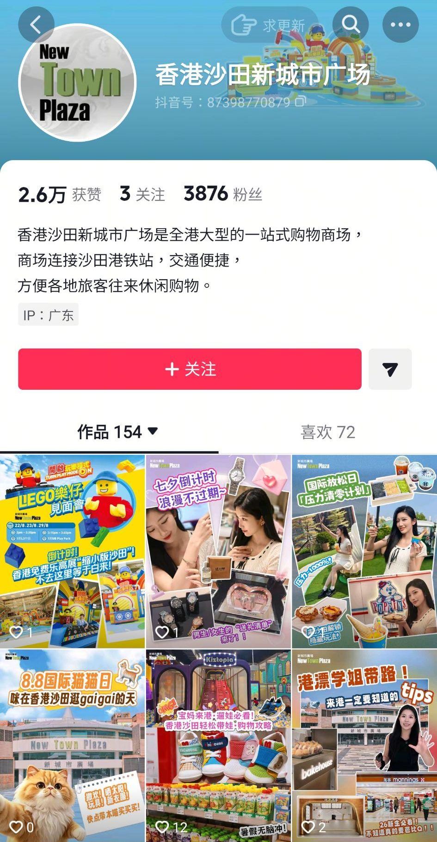

Competitor Content Analysis - New Town Plaza
Topic
Student Arrival Guide
Content
New Town Plaza drives engagement via a practical student-centric guide
Peer Perspective Hook: Leverages "senior student" perspective as the core hook, targeting incoming mainland students with practical advice covering essentials, electronics, beauty, and furniture
Local Living Curation: Positions the mall as a key hub for students, resonating with those seeking an easy start in Hong Kong by emphasizing value, convenience, and local authenticity
Suggestion: Langham Place can explore a similar "student arrival guide" series — covering Mong Kok-area accommodation, shopping, dining, and transport — to position the mall as the "first stop for students settling in Hong Kong."
Link

Slide 24


Competitor Content Analysis - K11 Musea
Topic
Luxury Pop-up x Local Culture – Immersive Check-in Experience
Content
K11 MUSEA drives engagement via a brand collaboration with cultural resonance
Local Culture Hook: Leverages a YSL pop-up inspired by Hong Kong's MTR stations, blending luxury beauty with local cultural elements to create a unique, relatable experience
Immersive Experience: Emphasises premium rituals and photo-worthy moments, turning a brand activation into a sensory journey that resonates with luxury consumers and experience seekers
Suggestion: Langham Place can adopt a similar "brand pop-up x local culture" model — collaborating with in-mall beauty or fashion brands to create thematic spaces inspired by Mong Kok's neon streets or local culture, generating buzz-worthy check-in content and driving foot traffic.
Link

Slide 25


Insights & Suggestions
Beauty Festival – Fashion & Beauty Challenge購物挑戰
Mid-Sept marks the Langham Place Beauty Festival, alongside fashion discounts and traveller offers. With the Mid-Autumn Festival and National Day holidays bringing a surge of mainland visitors.
we propose a topic with fashion & beauty:
e.g 假期挑战用xxxx钱在香港买大牌&潮牌
The content centers around the concept of "high-value shopping on a budget," appealing to price-conscious travellers while weaving in the Beauty Festival, fashion brands, and traveller perks.

Slide 26


Insights & Suggestions
Coffee Crawl – Mong Kok Coffee Map 港啡地圖
Late Sept brings “火星下的咖啡節” pop-up at Langham Place, spanning Golden Week. Coffee culture is a perennial high-traffic topic on XHS.
We propose a topic "Mong Kok Coffee Map", connecting in-mall coffee tenants, 咖啡節pop-up, and nearby hidden cafés. This topic strengthens local cultural relevance, sparks user curiosity, and appeals to both coffee lovers and Golden Week travellers, positioning Langham Place as a must-visit stop of Mong Kok coffee crawl.

Slide 27


Insights & Suggestions
Hong Kong must-buy items – 護膚及藥妝
"Hong Kong girls' skincare" and "Hong Kong drugstore must-buys" are perennially high-traffic topics on XHS, with demand surging during Golden Week as mainland visitors seek skincare and beauty products only available in Hong Kong. Langham Place, home to international beauty brands, offers a one-stop shopping advantage.
We propose a topic, e.g.「港女都在买！黄金周护肤品必买清单」featuring in-mall beauty brands and drugstore favourites, paired with Beauty Festival offers and traveller perks to attract mainland visitors.

Slide 28


Insights & Suggestions
Mooncake Taste Test – 朗豪坊月餅測評
Langham Place is home to multiple mooncake brands, including Maxim's, Kee Wah, and agnès b. CAFÉ. We can select key brands for seeding and conduct taste tests, covering flavour, texture, packaging, and value, providing consumers with a practical guide for Mid-Autumn Festival gifting and personal enjoyment.

Slide 29
KOL Campaign status
In chiikawa phase 2 campaign, we invited 7 x KOCs and 6 x Seedings to create total of 19 posts.
Until now, KOL campaign gained 110K+ views, 5.3K+ engagements and 4.85% engagement rate.
Total No.of KOC: 7
Total No.of Posts:
19 Videos
Total Views:
110,219
Total Engagement:
5,350
Engagement Rate: 4.85%
Data collected by Sep 3

Slide 30


KOL Campaign Summary
In Aug, we engaged 1 KOL for the Chiikawa campaign. Average views reached 5,801, representing a modest 4.9% MoM increase from Jul (5,531).
Aug saw reduced content output, with posts falling from 28 (Jul) to 19. For Chiikawa Campaign Phase 2, priorities tilted toward Chiikawa‑movie promotion and general Langham Place branding. The engagement rate eased from 7.89% to 4.85%, reflecting this shift in campaign focus instead of purely lower post volume.
While engagement metrics saw a moderate decline, the campaign still delivered top‑tier engagement efficiency given our limited KOL spend, resulting in robust brand activation outcomes.
Data collected by Sep 3

Slide 31



KOC Performance
7 KOCs generated 96,925 views and 4,329 engagements.
(average 13.8K views and 618 engagements/KOC)
Aug Chiikawa phase 2 engaged 7 KOCs for short‑form video deliverables with no ad boosting. In addition to XHS, four KOCs videos were also published on Douyin and Instagram to amplify reach.
The top‑performing KOC was 陳陳Chans, whose Douyin post went viral organically, generating over 58K views and over 1.8K engagements.
Unlike phase 1 (XHS only for both KOLs and KOCs), phase 2 strategically diversified across platforms to broaden campaign exposure and total views for the Chiikawa event.
To maximise reach, we leveraged summer, local, and Chiikawa‑related hashtags including #香港暑假, #朗豪坊Chiikawa, #Chiikawa大電影, #香港二次元, #香港吃谷, #香港打工人 etc.
The post by KOC 陳陳Chans went organically viral on Douyin.
Data collected by Sep 3

Slide 32



Seeding Performance
6 Seedings generated 13,294 views and 1,021 engagements. (average 2.2K views and 170 engagements/Seeding)
Views & Engagement: Suki 大王 delivered the highest video views and the strongest total engagement among all seeding posts.
Engagement Rate: 美少女战战 achieved the highest engagement rate at 10.57%. All seeding deliverables were short‑form videos, delivering a solid overall engagement rate of 7.68%, demonstrating positive organic performance from nano‑creator seeded content.
Top 2 KOCs seeding notes have been indexed under #朗豪坊chiikawa topic.
Data collected by Sep 3

Slide 33


Learnings & Insights
Cross‑platform Distribution:
Identical content yields vastly different results across platforms. For future XHS creator partnerships, we will ask influencers to repost content to additional channels including Douyin, Instagram where material has strong potential to go viral.
IP Thematic Positioning:
Throughout the Chiikawa campaign, KOCs consistently reinforced the "Chiikawa痛樓" theme in their content, successfully building a strong audience perception that "Langham Place is the must-visit destination for Chiikawa." This proven thematic anchoring strategy can be extended to future IP campaign.

Slide 34



金庸艺术雕像 KOL Campaign
1 KOL（100k+ fans）and 7 KOCS in 金庸 campaign.
Model: KOL‑led + KOC matrix amplification
Content Strategy: Feature Jin Yong Art Sculptures as key cultural highlight; combine Hong Kong deep‑travel routes (油麻地，旺角), embed Langham Place IP & Cordis Hotel, to build integrated culture‑art & travel content.
Core Objective: Increase exposure and discussion for #朗豪坊金庸艺术雕塑）

Slide 35
Thank You
Contact: info@dichat.hk

